Slide 1
The Cognitive era: Achieving sustained competitive differentiation through the Internet of Things
Sania Abbas, Business Unit Executive
IBM Watson Internet of Things
December 7, 2016

Slide 2
To outthink challenges, competitors and limits, you must conceive of new opportunities you couldn’t imagine before.
#WatsonIoT
#cognitive
Notes:
Businesses everywhere are becoming digital – and this has a substantial impact on the world. But when everyone becomes digital, who wins? In a world awash in data, it’ll be those who best understand that data. It’ll be those with cognitive capabilities.
Cognitive systems have the ability to think, to learn, to understand. They combine digital business with digital intelligence.
This represents a new relationship between machines and humans and a changing role of technology – from enabler to advisor. The cognitive era is about your response to that new potential. It’s about outthinking challenges, competitors and limits by sensing opportunities you’d never before imagined.

Slide 3
Your digital intelligence is your competitive advantage
Data you possess
Data outside your firewall
Data that’s coming
+
+
Structured and active
Unstructured and dark
#WatsonIoT
#cognitive
Notes:
Now, we said these opportunities start with digital intelligence – to provide insights needed to engage customers as individuals, for example, or to beat competition to market with new innovations.
But according to our recent C-suite studies, only about half draw on customer feedback. Less than a third glean insights from blogs and social media*.
Most businesses need to be a much better job capturing insights from all types of data – The structured data they know and have access to today, data from third parties, and new sources of data on the way.
The challenge is that as you go outside the firewall, data is increasingly unstructured. Traditional systems simply can’t process it.
*SOURCE: “Redefining Boundaries: Insights from the IBM Global C-suite Study,” IBM Institute for Business Value, September 2015.

Slide 4
The Internet of Things is becoming the world’s largest data source
10²³
(The number of stars in the universe)
Sensors and devices
World's Data (Bytes)
Social media
VoIP
Enterprise data
2010
2015
#WatsonIoT
#cognitive

Slide 5
The Internet of Things:
Digitizing the physical world
Notes:
By 2020: 30 billion connected things, IoT will generate 40% of all data
The IoT changes the way businesses create value, companies compete and partner, and consumers experience the world.

Slide 6
Digital business is giving way to cognitive
Organizations are becoming digital
Digital is foundation, not the destination
Cognitive is the game changer
Leaders understand data – and turn it into something new
IBM helps organizations in this transformation
A cognitive business:
... creates knowledge from data to expand expertise
... continually learns and adapts to outthink the needs of the marketplace
#WatsonIoT
#cognitive

Slide 7
IoT helps organizations in three areas
Operations
Marketing and sales
C-suite
#WatsonIoT
#cognitive

Slide 8
#WatsonIoT
#cognitive

Slide 9
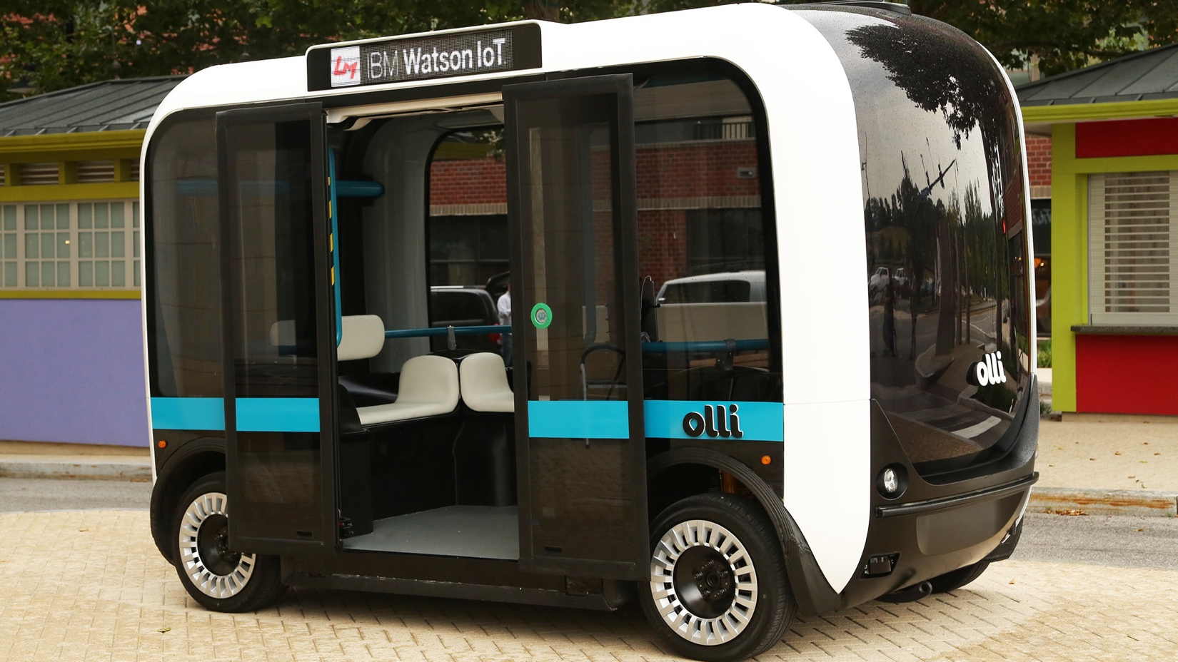
#WatsonIoT
#cognitive
Notes:
OLLI VIDEO
https://ibm.box.com/s/3j3mndksx7qkk4ivfhhgiksdy48fokvg

Slide 10
IBM commitment to IoT
$3 billion investment
6,000 clients in 170 countries
Client experience centres around the world
Analysts name IBM a market leader in IoT
Watson IoT Global Headquarters Munich, Germany
#WatsonIoT
#cognitive
Notes:
OLLI VIDEO
https://ibm.box.com/s/3j3mndksx7qkk4ivfhhgiksdy48fokvg

Slide 11
Welcome to the cognitive era
#cognitive
#WatsonIoT
@thesaniaabbas
Notes:
We chose just a few of the many business roles that are transformed by cognitive business.
Marketing and sales professionals are gaining deeper client insights and using them to craft end-to-end , cross-channel customer journeys.
Finance leaders are transforming financial performance management – by rethinking planning, budgeting, forecasting, profitability modeling, and reporting. They’re fueling more insightful financial decisions for better results.
Human resources leaders are finding new ways to recruit, empower, measure, reward and retain the best industry talent.
Operations leaders are [speaker notes to come]
This is business in the cognitive era.

