Slide 1
Security in a mobile-first, cloud-first world
Mina Nagy
Enterprise Mobility & Security
Notes:
The world has changed with mobility and cloud which are becoming the new normal.

Slide 2








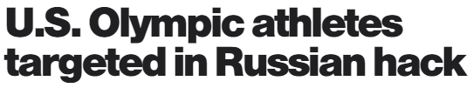












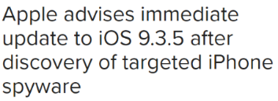
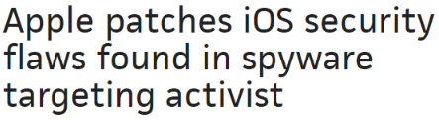













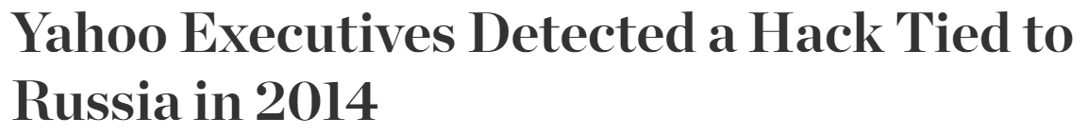






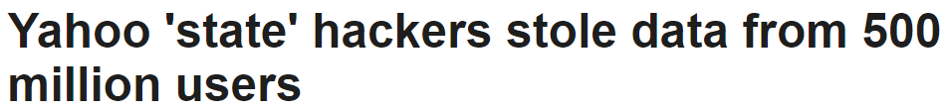

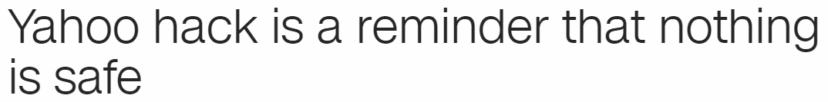

Notes:
For most of us, the recent Zero Day vulnerabilities in iOS are probably still fresh in our minds. To think that by simply clicking a link we get in a text, our device could be jailbroken and then completely owned by an attacker with access to literally everything stored and accessed by that device… this is an incredible reminder of the importance of securing and protecting our people and data.
http://www.gettyimages.com/license/72884732

Slide 3

Cybersecurity is the #1 priority
Notes:
Cybersecurity is among the most pressing and imperative issues in our industry, and yet, you are being asked to protect your core assets outside of your secure zone as your companies’ embrace the digital transformation to be competitive and attract talent that is used to a new way of working and collaborate.
Core parts of your business now run in the cloud, most companies underestimate their use of SaaS apps by an average of 20 times. Even when on-prem, data is being accessed from a variety of locations and devices, and often times by vendors, partners and providers, so more data sits outside of the firewall.
Security has quickly become one of the top priorities, if not the #1, for most organizations, as it is a key enablers of digital transformation.
Attacks are getting more sophisticated, more targeted, and more frequent as the value of the data rises, and the surface area you have to cover expands.
http://www.gettyimages.com/license/543196057

Slide 4

Notes:
The picture you see here [slide 7] is important – and I want to use it to illustrate something really important.
[click to slide 8]
This is Bamburgh Castle in northern England. In the 13th and 14th centuries it was among the pinnacles of engineering – and during the Middle Ages it was known to be completely impregnable. A king, his fortune, or his people were safer here than anywhere else in the known world.
No matter how large an army might be, no amount of swords or cavalry could breach this fortress.
And, as the centuries passed, Bamburgh remained strong, even as the world around it changed.
And then, in 1464, amidst the long and violent War of the Roses, the Earl of Warwick did something no one at Bamburgh had ever seen. He brought a canon.
Canons and gunpowder were not new, but the technology to use them accurately and at great distance was cutting edge. Warwick’s canons fired granite balls weighing 300 pounds, and the walls of Bamburgh came down quickly.
Old strength was no match for new technology.
This period of history is regularly punctuated by hardened defensive sites seeing their walls shattered by men like King James II who traveled the British countryside destroying castles with a canon named The Lion.
The fall of Bamburgh was shocking. But it was also inspiring.
Faced with this new reality of warfare, everyone stopped building castles. Initially there were some creative ideas about how you might redesign existing castles or change the geometry of their walls, but the era of hiding inside a stone box was over. No amount of innovation could change the fact that a castle was a huge, stationary target that, given enough time and resources, anyone could now knock down.
The giant hole punched in the side of Bamburgh showed the world saw a new way to operate, and technology surged to keep up – tech that was both offensive and defensive.
Now kings and generals had to rethink the way they operated. Old, time-tested methods of keeping their citizens and soldiers safe no longer applied. The way an army was organized and mobilized had to change now that giant stone and steel projectiles fell from the sky. And new professions and specializations sprung up in societies that had previously only required the brute strength necessary to lift a shield and march through the night.
Today I want to talk about an era of technology that has moved past perimeters, that regularly operates beyond firewalls, which is almost always mobile, and which is taking advantage of the very best technology to act offensively in support of productivity and defensively on behalf of your organization’s data.
https://upload.wikimedia.org/wikipedia/commons/0/07/Bamburgh_2006_closeup.jpg

Slide 5
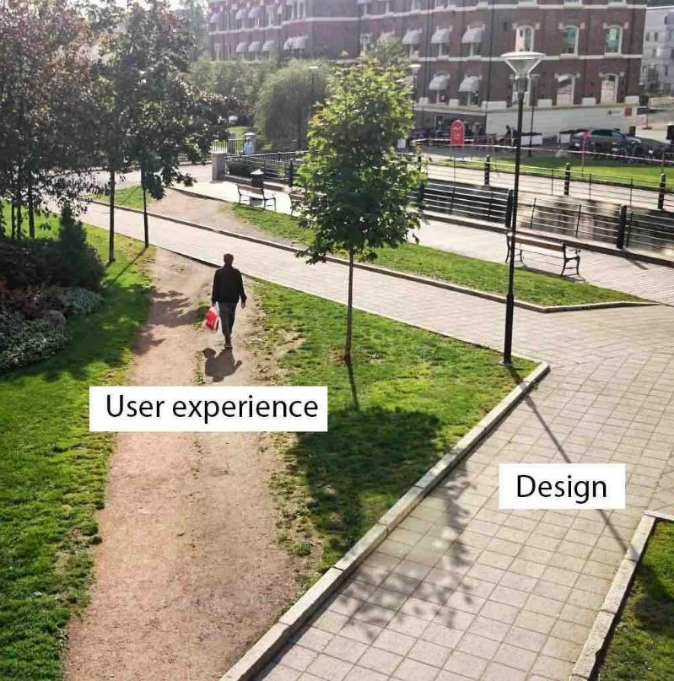
“People say the customer is always right, but you know what – they’re not. Sometimes they are wrong and they need to be told so.”
Michael O’Leary, CEO of Ryanair
Notes:
Users don’t always adhere to design
Users work the way that they want to work
Great Philosopher – They ain’t always right

Slide 6
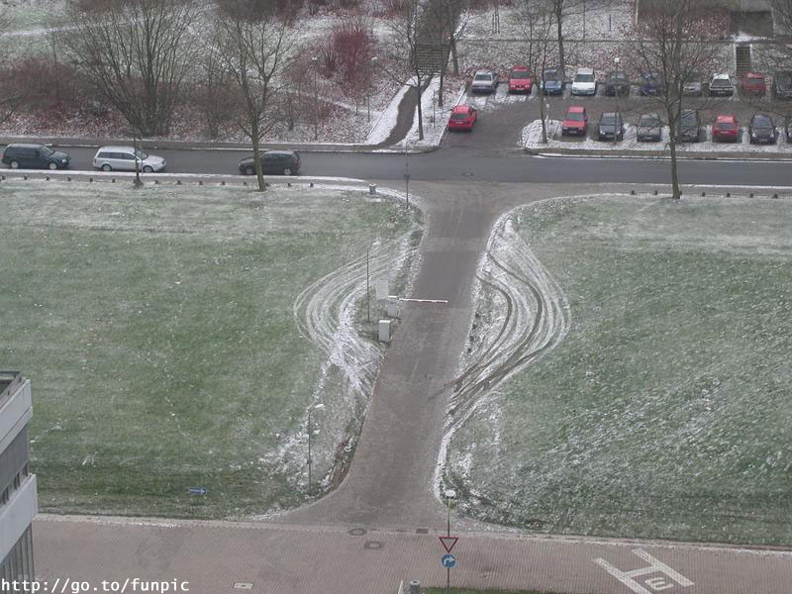
Maximum Security

Slide 7
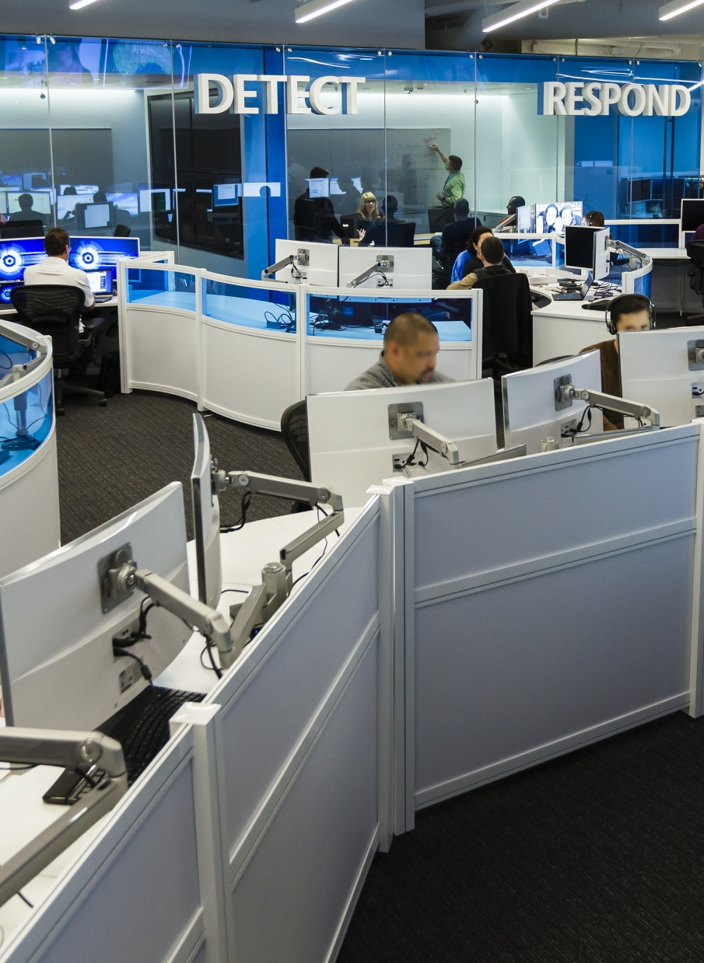
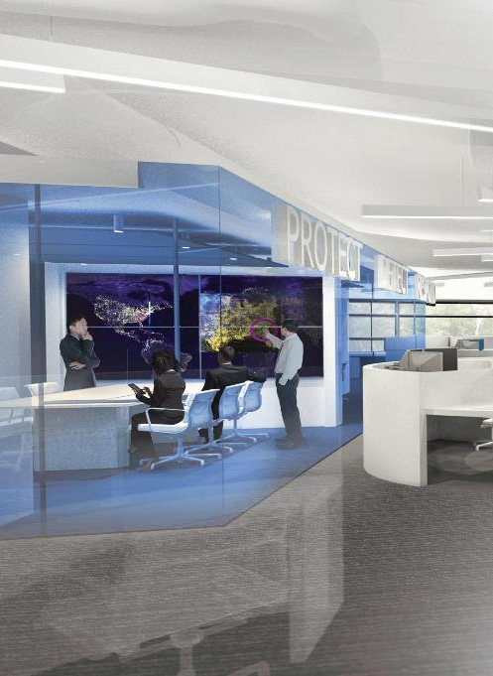
The End User Challenge
61% of workers mix personal and work tasks on their devices
>80% of employees admit to using non-approved SaaS applications in their jobs.
87% of Senior Managers admit to uploading work content to personal email or cloud accounts.
58% have accidentally sent information to the wrong person.
75% of Network Intrusions are due to weak, lost or stolen credentials.
Notes:
61% of workers mix personal and work (devices)
>80% of employees admit to using non-approved SaaS
87% of Senior Managers admit to uploading work
58% have accidentally sent information
75% of Network Intrusions

Slide 8
Attacks happen fast and are Hard to stop
If an attacker sends an email to 100 people in your company…
…23 people will open it…
…11 people will open the attachment…
…and six will do it in the first hour.
Source: Verizon 2015 Data Breach Investigations Report
Notes:
The audio talk track for this deck is can be found in the “Disrupt the revolution of cyber-threats with Windows 10” break out session from Ignite 2016: https://myignite.microsoft.com/videos/2805

Slide 9
THE ANATOMY OF AN ATTACK
:)
Healthy
Computer
User Receives Email
User Lured to Malicious Site
Device Infected with Malware
Notes:
Talk Track
So how do these attacks start? They’re many approaches but it’s not just vulnerabilities in the server infrastructure running on the edge of your network that you need to worry about. We’ve all gotten pretty good at addressing that risk.
The risk that we need to focus our attention on is our users. They can be hacked more easily than their devices through deception. For instance they can be tricked into inputting sensitive information, such as a user name and password, into a fraudulent website that looks remarkably like their corporate website. Some studies have shown users can be tricked in high percentages, around 75% in some cases ( http://www.businessweek.com/news/2013-11-15/the-human-hack-how-to-fight-an-internet-risk-technology-cant-fix). Think about that!
1. So let’s talk about one approach attackers are using at scale today. In this case we start with a healthy computer.
2. The user received a seemly innocuous email from their organization.
3. It lures the user to a malicious website that
4. either tricks them into installing malware or it leverages a vulnerability in the browser to install it behind the scenes without the users knowledge.

Slide 10




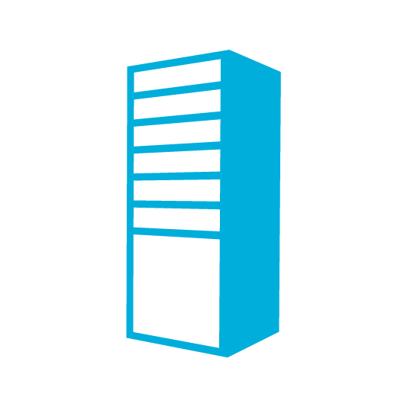
Notes:
Talk Track
From here the attacker will use the helpdesk users credentials and malware to access more end-points, steal more credentials, and within time they’ll very likely have a highly privileged IT account with administrative access to many network resources. From here your network is owned and stopping the cycle can be very difficult and at a minimum it will take time.
This is just one example and we could easily talk about many more but lets transition the conversation to how we’re going to address the threats.

Slide 11

Cybersecurity. In the news. In the boardroom.
1million
New pieces of malware created each day³
$3trillion
Yearly estimated market value destroyed from cybercrime industry²
140⁺days
Median # of days between infiltration and detection⁴
$15m
Average annual amount companies paid as a result of cybercrime¹
82%
Of all companies expect to face a cyber attack⁵
Notes:
Slide objective: Key stats to show why it matters
Key Points:
In today’s clouds first, mobile first world, it’s clear that increasing trust and managing security is something many organizations and individuals deeply struggle with.
$15 million is the average annual amount companies pay as a result of cybercrime
Over 1 millions new pieces of malware is created each day!
140+ days between infiltration and detection, on average.
As a result, the costs to global markets are staggering: Over $3 trillion in productivity and market growth destroyed last year due to security breaches alone.
The trust lost by individuals—customers, employees, and citizens—cuts much deeper and is even more challenging to restore. We all feel this pain.
Technology is the plane in which these attacks have occurred while at the same time it’s the plane in which they can be fought.
When I hear of a major attack and talk to that company’s CEO whether it be a customer, competitor, partner or provider I have two questions: what can we collectively learn? How can I help?
The question for Microsoft is how can we help? That’s what today is about.

Slide 12
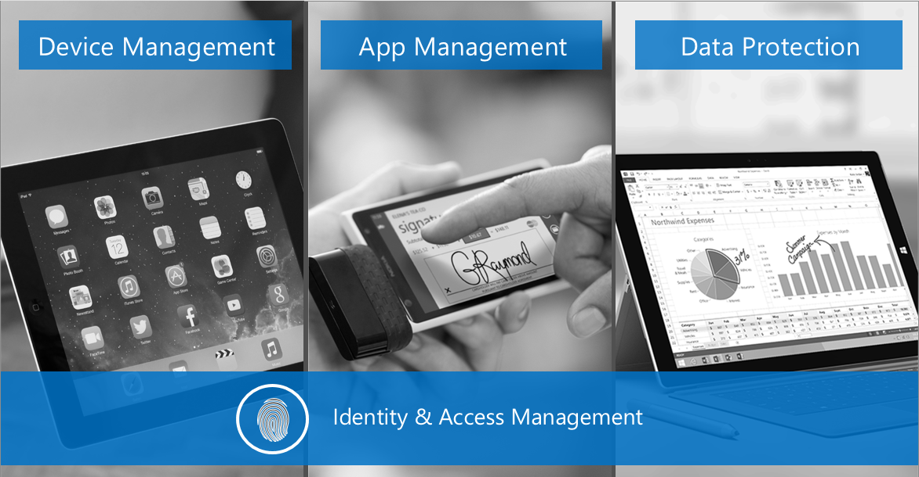

Slide 13












Enterprise Mobility + Security
Extend enterprise-grade security to your cloud and SaaS apps
Microsoft Cloud App Security
Microsoft
Intune
Azure Active Directory Premium
Manage identity with hybrid integration to protect application access from identity attacks
Azure Information Protection
Protect your data, everywhere
Protect your users, devices, and apps
Detect threats early with visibility and threat analytics
Microsoft
Advanced Threat Analytics
Notes:
Microsoft’s enterprise & security solutions provide a holistic framework to protect your corporate assets across, on prem, cloud and mobile devices
Advanced Threat Analytics helps IT detect threats early and provide forensic investigation to keep cybercriminals out
Azure Active Directory Premium security reports help identify risky log ins. That paired with Azure Active Directory Identity Protection gives IT the ability to automatically block access to apps based on real time risk scoring of identities and log ins.
Microsoft Cloud App Security provides deep visibility and control of data inside cloud applications
Microsoft Intune manages and secures corporate data on mobile devices and collaborated within corporate apps.
Azure Information Protection helps keep data secure and encrypted throughout a customers environment and extends security when data is shared outside the organization.

Slide 14

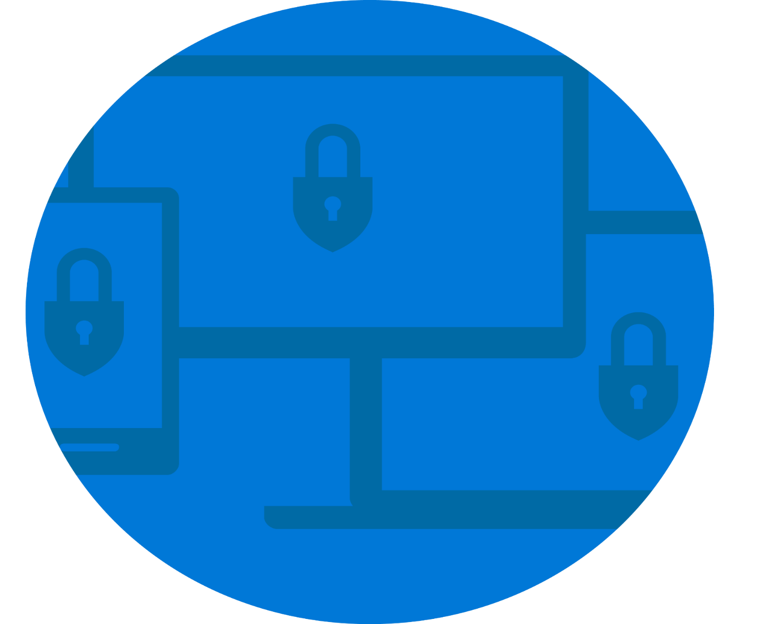

How much control do YOU have?
Unregulated, unknown
Hybrid data = new normal
It is harder to protect
Identity, device management protection
Managed mobile environment
Perimeter protection
On-premises
Notes:
You had control over your data when it resided within your boundaries
Now that boundary has expanded with managed devices and cloud assets. MDM solutions help but not when data moves outside of your controlled environment
Once shared outside your environment, you lose control over your data.

Slide 15
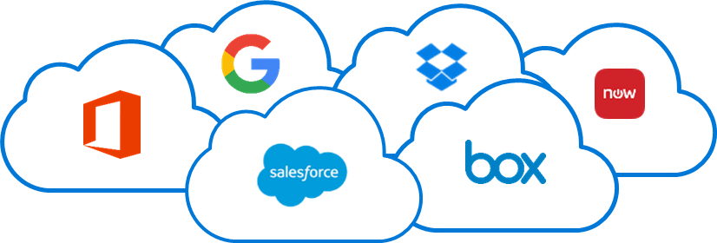
Key challenges for cloud adoption
DATA PROTECTION
An employee publicly shares a sensitive file in the cloud.
How can we detect that?
THREAT PREVENTION
How do I know if my users have been breached?
SHADOW IT
  Office 365 is rolled out.
  How do we know which groups are using other apps?
ACCESS CONTROL
  A sales rep uses an airport kiosk to download customer details.
  How can we detect and limit access?

Slide 16

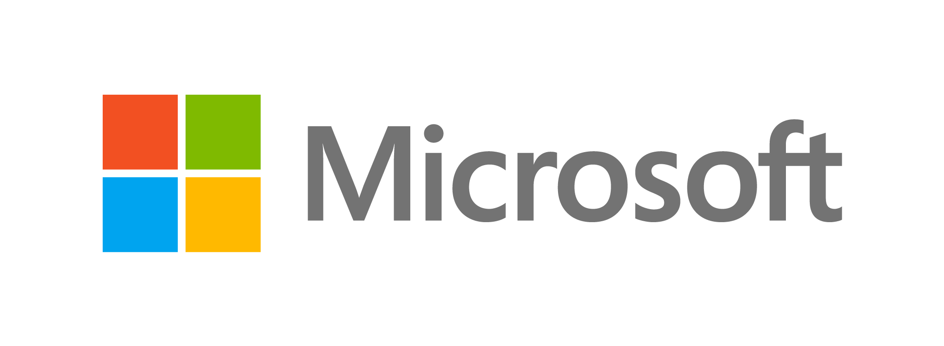
Microsoft mission
Empower every person and
every organization on the
planet to achieve more
Notes:
MSFT Field - Please view associated material at: https://microsoft.sharepoint.com/sites/Infopedia_G01/Pages/OneMicrosoftSecurity.aspx

Slide 17
PROTECT
across all endpoints, from sensors to the datacenter
DETECT
using targeted signals, behavioral monitoring, and machine learning
ASSUME COMPROMISE
MINDSET
!
RESPOND
closing the gap between discovery and action
Notes:
So, our security strategy has evolved. Five to ten years ago, the focus was on securing the perimeter. Organizations deployed edge firewalls, proxies, well-crafted Access Control Lists etc. to stop the attacker getting past the perimeter. However, there are challenges with an approach like this – defenders need to be successful 100% of the time, the attacker needs to be successful just once. So we now have adopted an “Assume Compromise” mindset – we still invest in those edge defenses, but we assume that an attacker will get inside; this gives us the permission to think from the attacker perspective – where would I go? What would I do?
This thinking then feeds into the Protect-Detect-Respond cycle – every time an organization makes a change, they learn something. That experience informs the next move.
So, in summary, we are trying to do three things – stop the attacker getting inside the network; but when the attacker does get inside, we want to stop them moving around; but when they do move around, we want to stop them getting to the High Value Assets, the crown jewels, and stop them destroying, damaging, or stealing the assets. Let’s talk about how we can do that.

Slide 18
OUR UNIQUE APPROACH
PLATFORM
INTELLIGENCE
PARTNERS
Notes:
Our unique security perspective
Microsoft’s holistic security approach extends across the
entire enterprise estate. We not only own our workloads and technology, we help secure the entire enterprise estate for customers. We do this in three ways:
Platform
We build security from the ground up in all of our products. Yes we secure Windows, Office, Azure, AND
we extend that across all parts of your systems—devices, identity, apps and infrastructure, and even data.
And because we own those workloads we provide security built-in versus bolt-on, and extend from there.
Intelligence
All the protection in the world can’t stop hackers, so we need to focus on detection after the fact. We’re using machine learning to identify and detect issues early and accurately. We have more than 300B user authentications per month, 1B Windows devices updated, 200B emails analyzed for span and malware. This gives us visibility into risky behaviors and potential risks before they happen.
Diversity of signal: Our unique value is that we have both breadth and depth, we’re working across every technology in our portfolio and we are getting data from the public cloud (Xbox, Hotmail, Outlook.com), as well as private cloud (Azure, O365, CRM, etc.).
Complement that with human intelligence:
Digital Crimes Unit (DCU), Cyber Defense Operation Center (CDOC)—our cybersecurity experts monitor all
this information to identify real threats. This combination
of machine learning and human vigilance equals
holistic protection.
Partner
We co-exist with other security providers in your company. Most organizations have over 40 security vendors. It is a broad ecosystem and highly fragmented.
We are one of many and we’re going to come in and work with the ecosystem as a coordinated effort. We’re not advocating total removal of your existing tools or pushing you to adopt all of our technologies.
We’re going to look at your business and security goals, and make recommendations. We work with the security industry in a partnership approach. We’re working in conjunction with security organizations worldwide and sharing our results and updates with those organizations to improve security overall.

Slide 19
OUR UNIQUE APPROACH
Identity
PLATFORM
Device
Apps & Data
Infrastructure
Notes:
People – identity, device, apps, data
Built-in vs bolt on
Identity is the new control plane
Data protection should be permanently embedded as data travels to places not under your control

Slide 20

Protect
Identity is the
new control plane
Notes:
Because the movement of data to and from the cloud has weakened the perimeter security we’ve historically relied upon, identity has become the new perimeter. Said another way: Identity is the foundation of your modern management and security platform.
In a workplace that is increasingly mobile and cloud-centric, it is the user’s identity that unlocks access to the corporate resources. Whether that data is behind a firewall or in the cloud, identity is the token that grants access. We know that, attackers know that too. Securing identity is the first step to protect your data.
If you’ve been watching the news carefully, however, you also know that the bulk of the security breaches happening around the world can be traced back to compromised user account, in fact 63% of confirmed data breaches involve weak, default or stolen passwords.
http://www.gettyimages.com/license/605558075

Slide 21
Root cause of +75% of intrusions:
Compromised credentials
Notes:
Security and device management cannot be isolated disciplines within IT, 58% of workers admit to have accidentally sent sensitive information to the wrong person, 90% of data leakages can be traced back to user behavior - intentional or unintentional. We see a lot more companies running mobility and security as side by side projects, or SaaS apps adoption and security.
I’ve been working on device management and security for more than 25 years, and, looking back, it was so much easier when all the devices were domain joined corporate PCs accessing data that existed exclusively behind a firewall. The policies that IT defined in this world were what I call “Thou Shalt” polices – these were configurations that were forced on to devices without any user interaction or permission. As we see the number of personal devices entering the workforce, it’s obvious that IT has to expand its repertoire to include “Access is Allowed If” policies.
http://www.gettyimages.com/license/184641355

Slide 22


AZURE ACTIVE DIRECTORY
Identity and access management from the cloud
Protect users
Multi-factor authentication
Leaked credentials reporting
Intelligent analysis
Machine learning
Risk-based conditional access
User behavior analysis
Guard apps
Conditional access
Secure remote access

Slide 23








Access your app portfolio, stay secure, be efficient
Greater transparency with on-demand admin access
Convenient self-service capabilities
Single sign-on to all apps
More granular conditional access
Monitor and protect identity

Slide 24
Conditional access, beyond device state checks
Conditions
Actions
Location (IP range)
Microsoft Azure
Device state
Allow
Remediate
User
User group
Enforce MFA
Risk
Block access
Wipe device
On-premises
applications
MFA
Notes:
While Office 365 does include ‘device state’ based conditional access to Office 365 resources, this capability is enhanced by EMS to include both a much more comprehensive set of conditions, as well as enabling access to a large set of apps beyond Office 365 – from apps like Salesforce and Workday to custom, on-premises apps.

Slide 25

A more productive, more secure access experience
      Ensure the right people have access to
      apps and files under the right conditions.
Microsoft Azure
On-premises
applications
      Empower users with self-service options.
      Adjust access policies in real time with machine learning.
      Enable compliant users with easy access to all resources.

Slide 26
Single sign-on to Office 365 and all other applications
Microsoft Azure
On-premises
applications
EMS connects your workforce to 1000s of cloud and on-premises applications using one unified identity.
SINGLE SIGN-
ON TO ALL APPS
User
Notes:
Increase productivity and reduce helpdesk costs with self-service and single sign-on experiences
{JM – Deliver; we lost the company portal section, does that make sense to include?}
Employees are more productive when they have a single username and password to remember and a consistent experience from every device. They also save time when they can perform self-service tasks like resetting a forgotten password, or requesting access to an application, without waiting for assistance from the helpdesk.

Slide 27
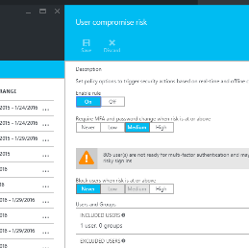
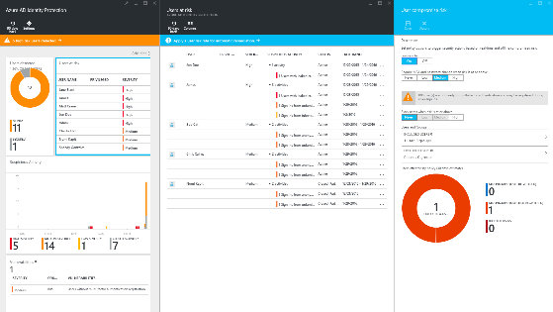
Monitor, assess, and protect Identity
Infected devices
Leaked credentials
Configuration vulnerabilities
Gain insights from a consolidated view of machine learning based threat detection.
Brute force attacks
Suspicious sign-in activities
Risk-based policies
Remediation recommendations
Machine-Learning
Engine
Risk severity calculation
MFA Challenge Risky Logins
Risk-based conditional access automatically protects against suspicious logins and compromised credentials.
Change bad credentials
Block attacks
Notes:
Risk classification
In addition to addressing user- or device-based vulnerabilities, it’s important to consider the rest of the threat landscape, which can be highly complex.
Even the most sophisticated attacks leave behind traces that can form detectable patterns. Every month Microsoft processes a tremendous volume of these signals. In addition, we update more than 1 billion PCs, service more than 450 billion authentications , and analyze more than 200 billion emails for malware and malicious websites. Our threat intelligence systems see just about every kind of attack there is and we push all that data directly into our Microsoft Intelligent Security Graph.
The unique graph pulls together telemetry and signals from the hundreds of cloud services that Microsoft operates, extensive and ongoing research that identifies emerging attack vectors and malware, as well as data from partnerships with industry leaders and law enforcement organizations. We apply our machine learning and data analytics to identify anomalous and suspicious activities that characterize advanced and persistent attacks. The graph makes it possible for us to deliver recommendations and automated actions to help prevent attacks and to counter them. It achieves that by calculating and assigning a risk level (low, medium or high) to every sign-in activity and user account based on the gathered data. A risk score is also assigned to possible configuration vulnerabilities such us administrators with weak authentication options or lack of MFA initial configuration for end-users
Based on this risk classification, conditional access policies can be applied and block access for users in high risk or for high risk sign-ins while for medium or low risk users and events additional authentication steps, such us multi-factor authentication, password reset or device enrolment, can be required before access is granted
The most common events that affect the risk calculation are described below
Leaked credentials
Microsoft security researchers search for credentials that have been posted on the dark web, which usually appear in plain text. Machine learning algorithms compare these credentials with Azure Active Directory credentials and report any match as “leaked credentials.”
Impossible travel or atypical locations
Machine intelligence detects when two sign-ins originate from different geographic locations within a window of time too short to accommodate travel from one to the other. This is a pretty good indicator that a bad actor succeeded in logging on. Machine intelligence also flags sign-ins at atypical locations by comparing them against past sign-ins of every user. Sign-ins from familiar devices or sign-ins from or near familiar locations will pass.
Sign-ins from possibly infected devices
The Microsoft Intelligent Security Graph maintains a list of IP addresses known to have been in contact with a bot server. Devices that attempt to contact resources from these IP addresses are possibly infected with malware and are therefore flagged.
Sign-ins from anonymous IP addresses
People who want to hide their device’s IP address, often with malicious intent, frequently use anonymous proxy IP addresses. A user successfully signing in from an anonymous IP address is flagged as a risky event, A risk-based conditional access policy can be applied so MFA will be required as an additional proof of identity if the risk score is medium
Sign-ins from IP addresses with suspicious activity
Multiple failed sign-in attempts that occur over a short period of time, across multiple user accounts, and originate from a single IP address, also trigger a risk event. Traffic patterns that match those of IP addresses used by attackers are a strong indication that accounts are either already compromised or will be very soon, although the traffic pattern may also originate from an IP address shared with multiple devices via a router or similar device.

Slide 28
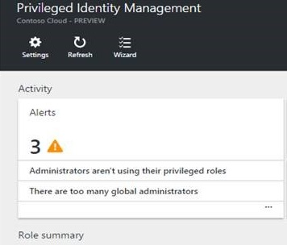
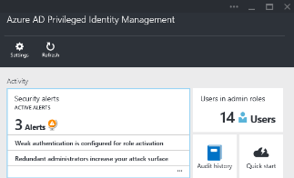
Manage privileged identities
Enforce on-demand, just-in-time administrative access when needed.
Gain more visibility through alerts, audit reports, and access reviews.
Global Administrator
Billing Administrator
Exchange Administrator
User Administrator
Password Administrator
Notes:
Discover permanent administrators in your organization- use as is
Enforce on-demand, just-in-time administrative access when needed
Security Wizard simplifies converting permanent admins to eligible admins
Alerts on users who haven’t been using their roles
Audit reports and Access reviews enable determining who still needs administrative rights

Slide 29

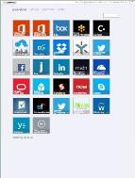

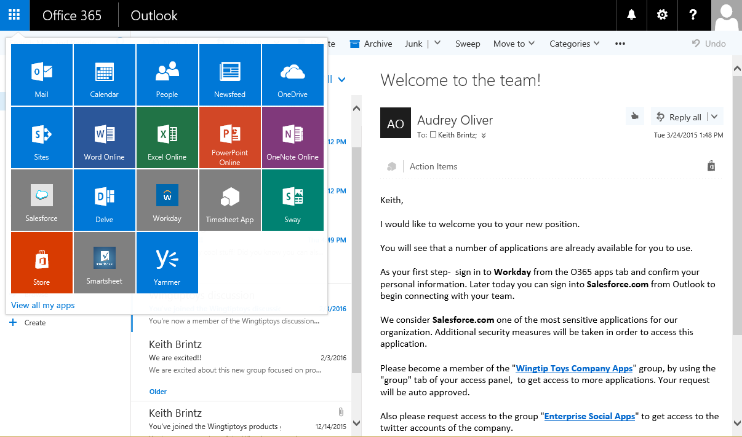
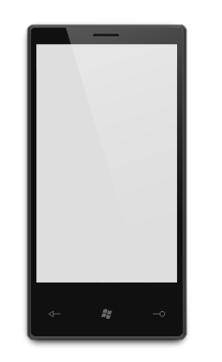
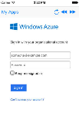
More convenience, less cost with self-service options
Self-service capabilities in
EMS include:
Self-service password reset
Account, apps and group management
Integrated Office 365 app launching
Application access requests
Notes:
EMS provides self service capabilities that reduce reliance on costly helpdesk remediation for routine access issues like password reset and group assignment

Slide 30
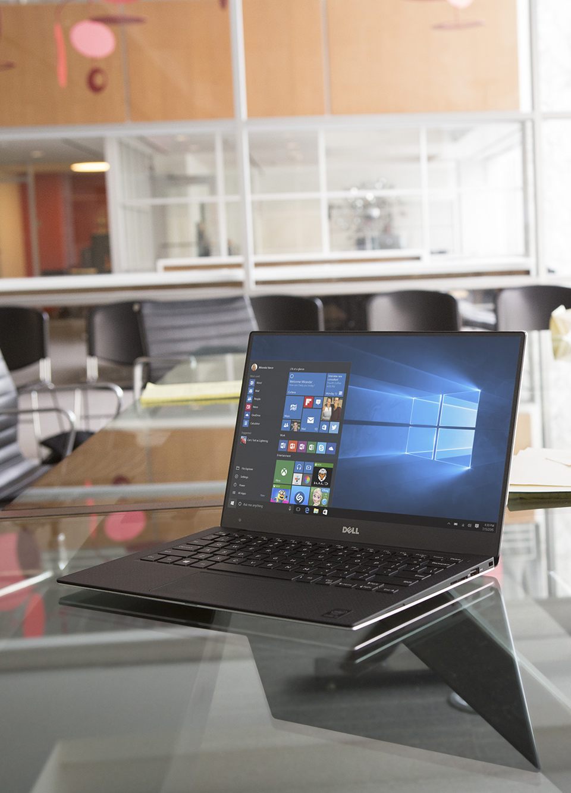

WINDOWS 10
IDENTITY PROTECTION
Protecting user identities from theft and misuse
Windows hello
A convenient enterprise grade alternative to passwords that is designed for today’s mobile-first world
Uses a natural (biometrics) or familiar (PIN) as a means to validate a user’s identity using the devices they already have rather than requiring additional peripherals
Includes all of the security benefits of smartcards without all of the complexity
Credential guard
Prevents theft of user credentials that enable attackers to move laterally across devices and corporate networks (i.e., Pass-the-Hash (PtH))
Protects credentials by placing them within a hardware isolated container, which helps ensure they can remain secure even when the operating system
is fully compromised

Slide 31
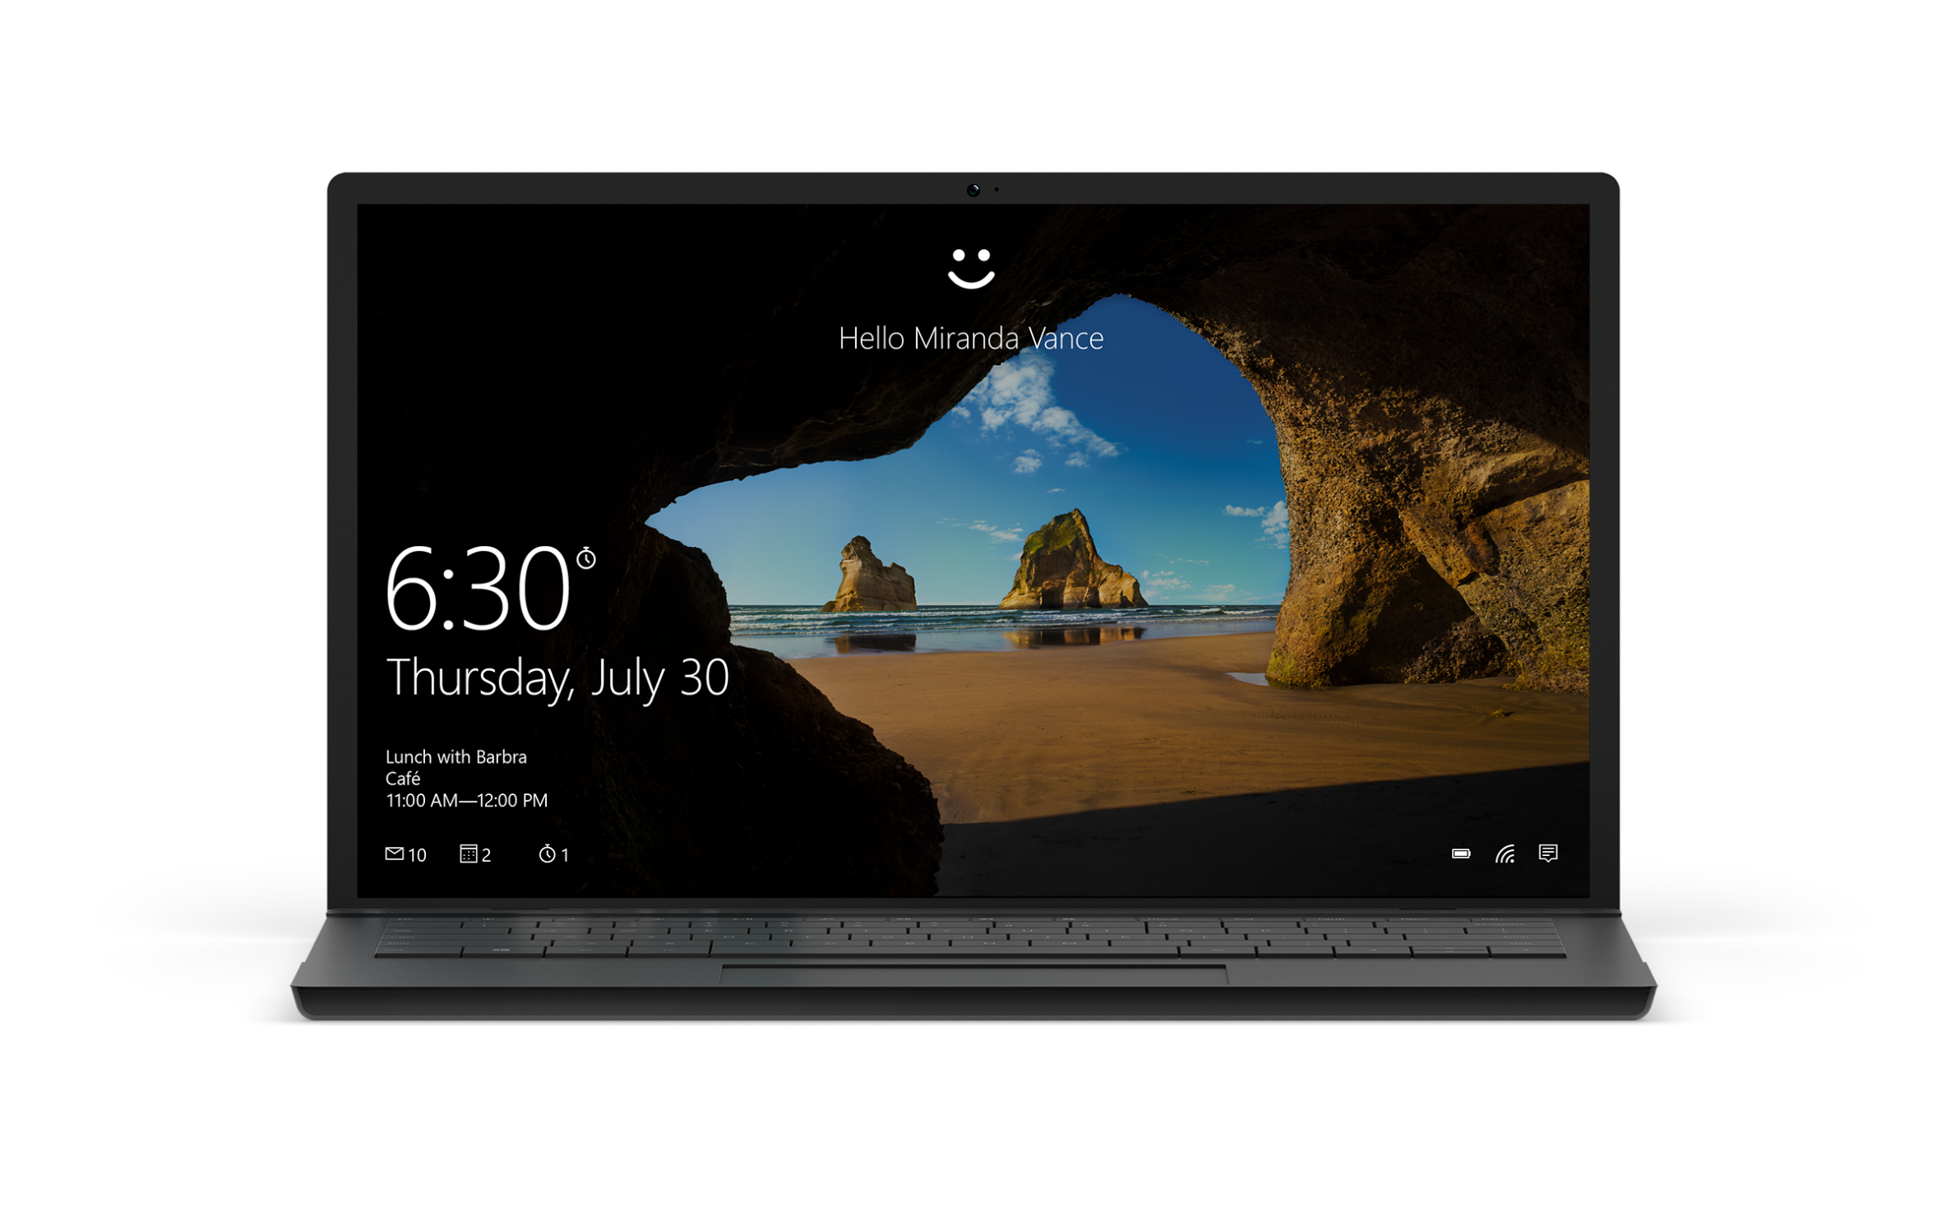
[ SAY HELLO ]
Notes:
Bu it’s the mobility of the human experience – not the of the device – that is truly important.
Our vision is for a single platform that spans all these device types. A single platform that creates a seamless, connected experience.
All of these devices, not to mention wearables, holographic and VR devices need to be connected.
Fueled by Common apps and a single platform. With a consistent and familiar experience. Powered and enabled by the cloud. Designed from the group up to just work together.
Ultimately allowing you to be productive using whatever device you have most conveniently to hand.
“A single platform that creates a seamless, connected experience.”
Key points to land
Mobility of human experience
A single, connected platform
Powered by the cloud
Consistency of experience, apps
Just works for the user
Key products to highlight
Universal Apps

Slide 32

Detect
Notes:
Security and device management cannot be isolated disciplines within IT, 58% of workers admit to have accidentally sent sensitive information to the wrong person, 90% of data leakages can be traced back to user behavior - intentional or unintentional. We see a lot more companies running mobility and security as side by side projects, or SaaS apps adoption and security.
I’ve been working on device management and security for more than 25 years, and, looking back, it was so much easier when all the devices were domain joined corporate PCs accessing data that existed exclusively behind a firewall. The policies that IT defined in this world were what I call “Thou Shalt” polices – these were configurations that were forced on to devices without any user interaction or permission. As we see the number of personal devices entering the workforce, it’s obvious that IT has to expand its repertoire to include “Access is Allowed If” policies.
http://www.gettyimages.com/license/184641355

Slide 33
58% of workers have accidentally sent sensitive data to the wrong person
Notes:
Security and device management cannot be isolated disciplines within IT, 58% of workers admit to have accidentally sent sensitive information to the wrong person, 90% of data leakages can be traced back to user behavior - intentional or unintentional. We see a lot more companies running mobility and security as side by side projects, or SaaS apps adoption and security.
I’ve been working on device management and security for more than 25 years, and, looking back, it was so much easier when all the devices were domain joined corporate PCs accessing data that existed exclusively behind a firewall. The policies that IT defined in this world were what I call “Thou Shalt” polices – these were configurations that were forced on to devices without any user interaction or permission. As we see the number of personal devices entering the workforce, it’s obvious that IT has to expand its repertoire to include “Access is Allowed If” policies.
http://www.gettyimages.com/license/184641355

Slide 34

INTUNE
Manage and secure mobile productivity
Access management
Conditional access
Compliance enforcement
Multi-identity support
Mobile device &and app protection
Manage iOS, Android, and Windows devices
Protect data in corporate apps with or without
a device enrollment
Office 365 mobile app integration
Prevent leakage of corporate data in Office 365
mobile apps to personal applications
Extend app-level management to other LOB
apps via Intune SDK

Slide 35







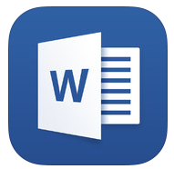
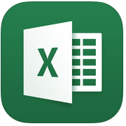






Comprehensively manage and protect Office Mobile apps
Multi-identity policy
MAM
policies
Corporate
data
Corporate apps
Microsoft Intune
Personal
data
Azure Rights Management
  Protect Office Mobile app data with
    App encryption at rest
    App access control – PIN or credentials
    Save as/copy/paste restrictions
    App-level selective wipe
  Extend protection to line of business and third-party apps
MDM – optional
(Intune or third party)
Personal apps
MDM
policies
Notes:
Building on the ease of use and experience of the Office Mobile Apps, EMS (through Intune) brings you an unparalleled set of capabilities to granularly manage the Office experience - thereby helping IT to perfectly balance productivity and protection.
Moreover, these capabilities extend beyond the Office Apps; app wrapping, access and other capabilities can be extended to your Line of Business Apps, as well a growing set of 3rd party apps too.

Slide 36
Protect with and without enrollment
Intune gives you the option to manage the data, without the need to manage the device.
A great option for BYOD scenarios where your end users may be reluctant to enroll their personal devices.
Notes:
Mobile application management without enrollment - gives you the flexibility to control Office Mobile and other applications on your users’ iOS, Android, and Windows devices without enrolling the device on Intune.
This also means that, for customers who already have an MDM vendor, or don’t wish to manage their users’ devices via MDM, they can still protect access to Office and company data. This includes cut/copy/paste restrictions, preventing ‘save-as’, jailbreak detection, PIN requirements and the ability to remote wipe MAM protected data.

Slide 37


OFFICE 365 ADVANCED
THREAT PROTECTION
SAFE ATTACHMENTS
SAFE LINKS
URL TRACKING

Slide 38
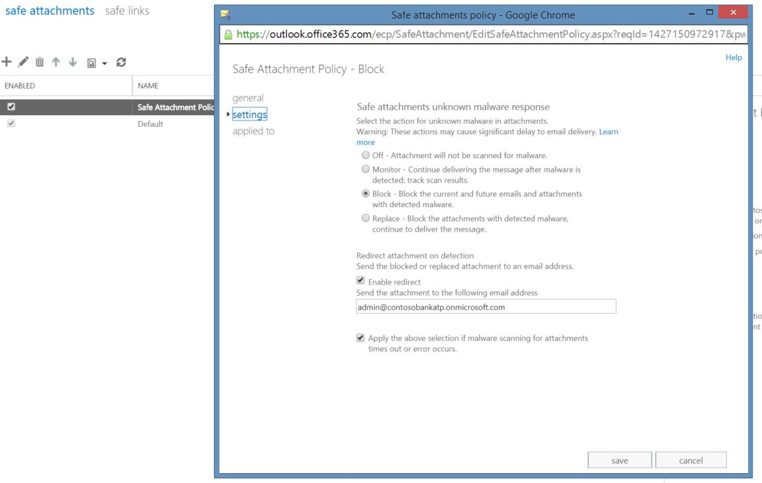
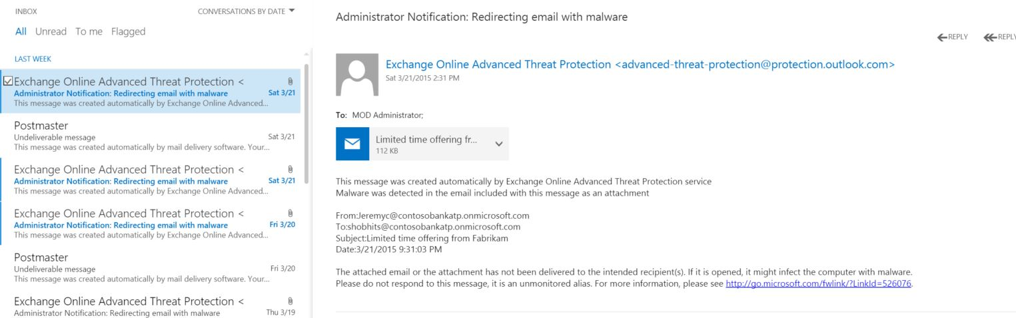
Safe attachment—experience
Admin sets policy
Admin gets notification if message is blocked

Slide 39
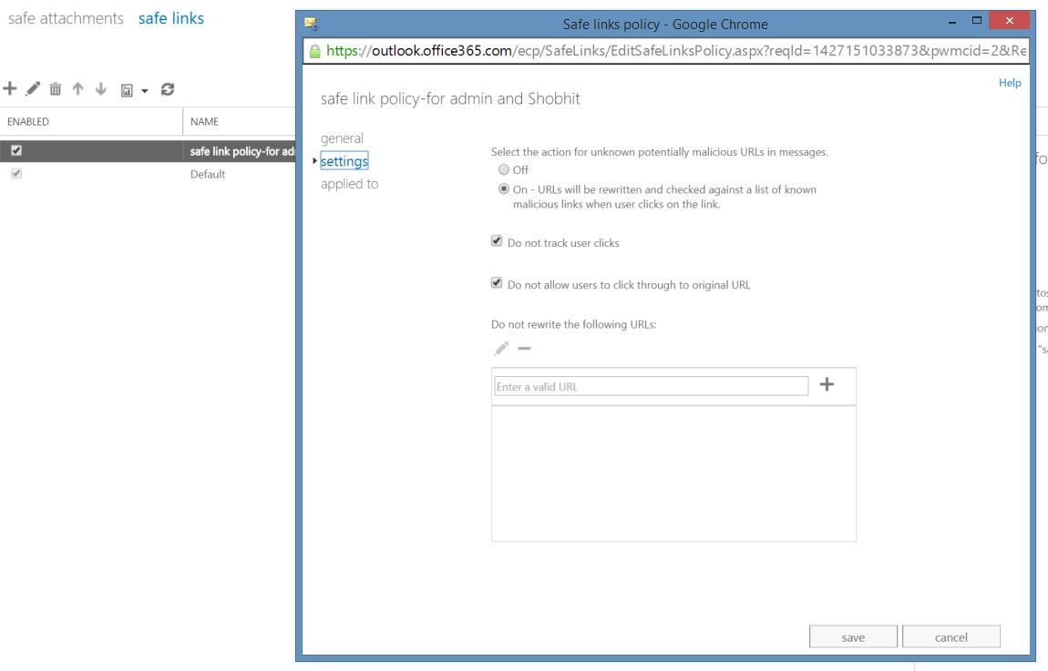
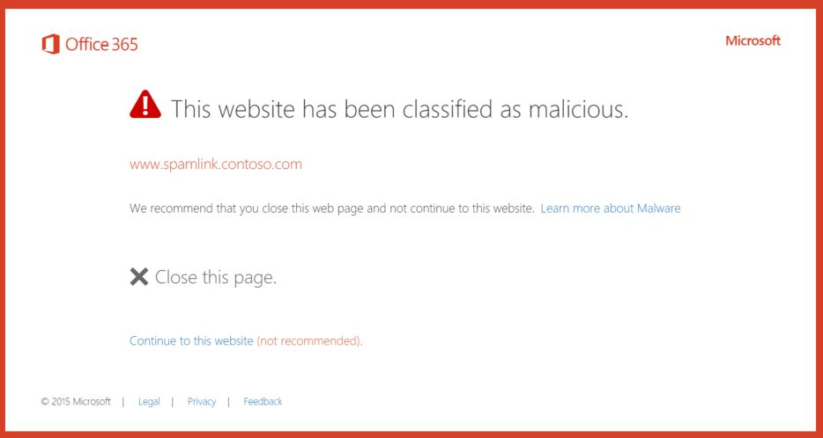
Safe links—experience
Users notified if a malicious link is clicked in email
Admin sets policy

Slide 40
Do you know where your information is?

Slide 41

The evolution of Information Protection
CLASSIFICATION
LABELING
ENCRYPTION
ACCESS CONTROL
POLICY ENFORCEMENT
DOCUMENT TRACKING
DOCUMENT REVOCATION
Classification & labeling
Protect
Monitor & respond
Notes:
1.For years, RMS helped businesses provide persistent protection over their data through encryption, access control and policy enforcement
2.We added tracking and revocation capabilities for greater control over shared data
3. Now we also have classification and labeling capabilities so that you can identify what data needs protection and protect only the data that needs protection

Slide 42
Azure Information
Protection
Full Data Lifecycle
CLASSIFICATION
LABELING
ENCRYPTION
ACCESS CONTROL
POLICY ENFORCEMENT
DOCUMENT TRACKING
DOCUMENT REVOCATION
Classification & labeling
Protect
Monitor & respond
Notes:
1.For years, RMS helped businesses provide persistent protection over their data through encryption, access control and policy enforcement
2.We added tracking and revocation capabilities for greater control over shared data
3. Now we also have classification and labeling capabilities so that you can identify what data needs protection and protect only the data that needs protection

Slide 43
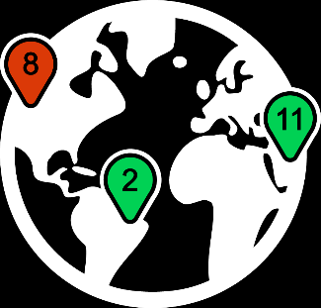






Collaboration: monitor shared files, respond to potential leaks
Track who accessed the data, when, and where
Map View
Revoke access in the case of unexpected sharing
Bob
Sue
Jane
Sue
Bob accessed from South America
Jane
Competitors
Jane accessed from India
Jane’s access is revoked
Joe blocked in North America
Jane blocked in Africa
Notes:
EMS also adds visibility and control – for even better data protection.
Track activities for shared data and revoke access if necessary.
Your IT team can use powerful logging and reporting to monitor, analyze, and reason over data.

Slide 44
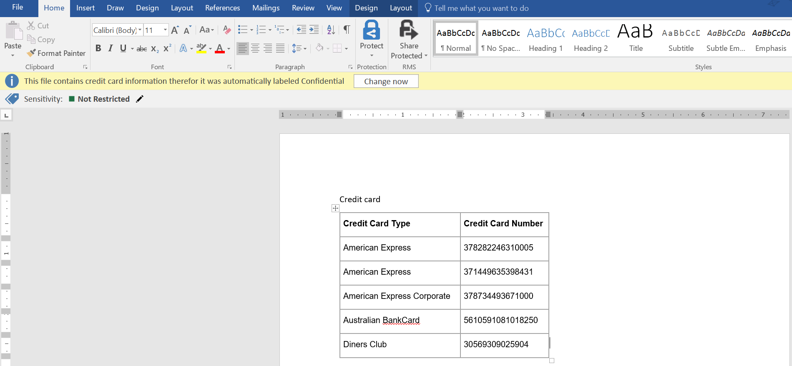
Recommended classification - example

Slide 45
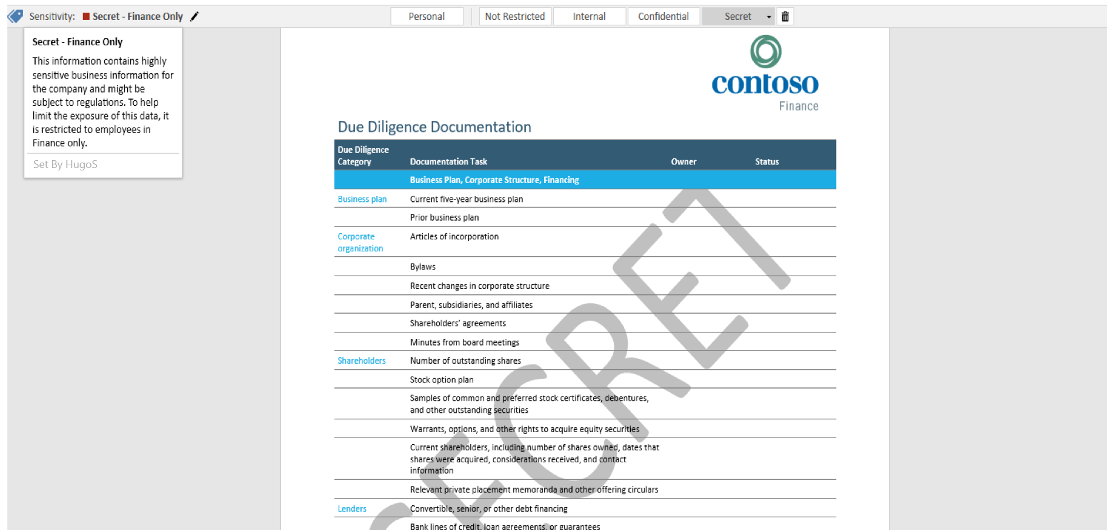
User-driven classification - example

Slide 46
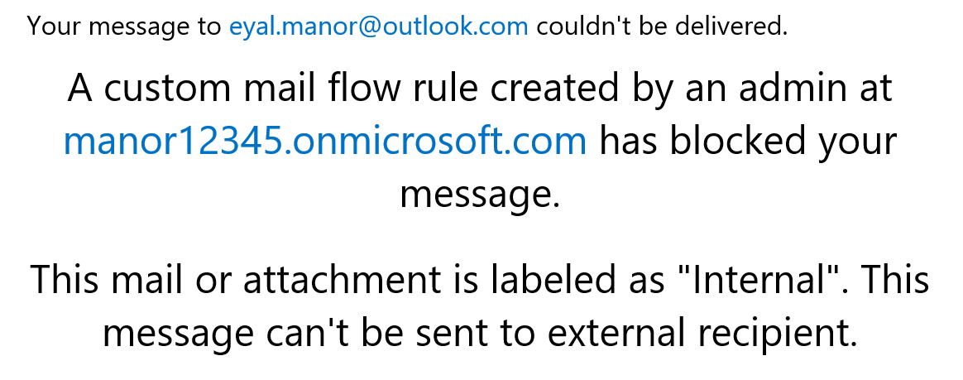
DLP actions based on labels

Slide 47
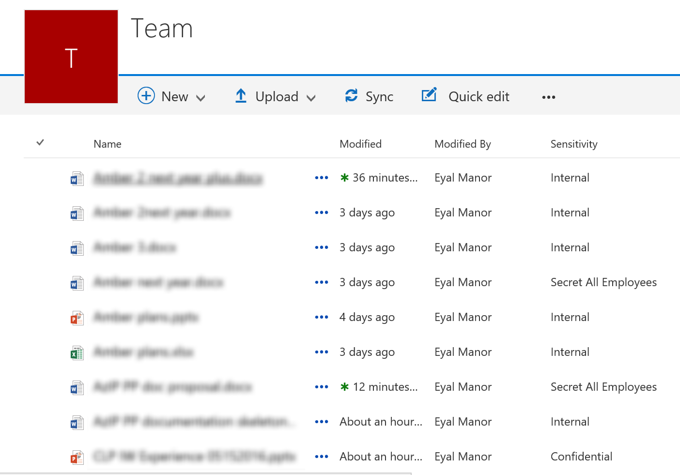
SPO columns based on labels

Slide 48
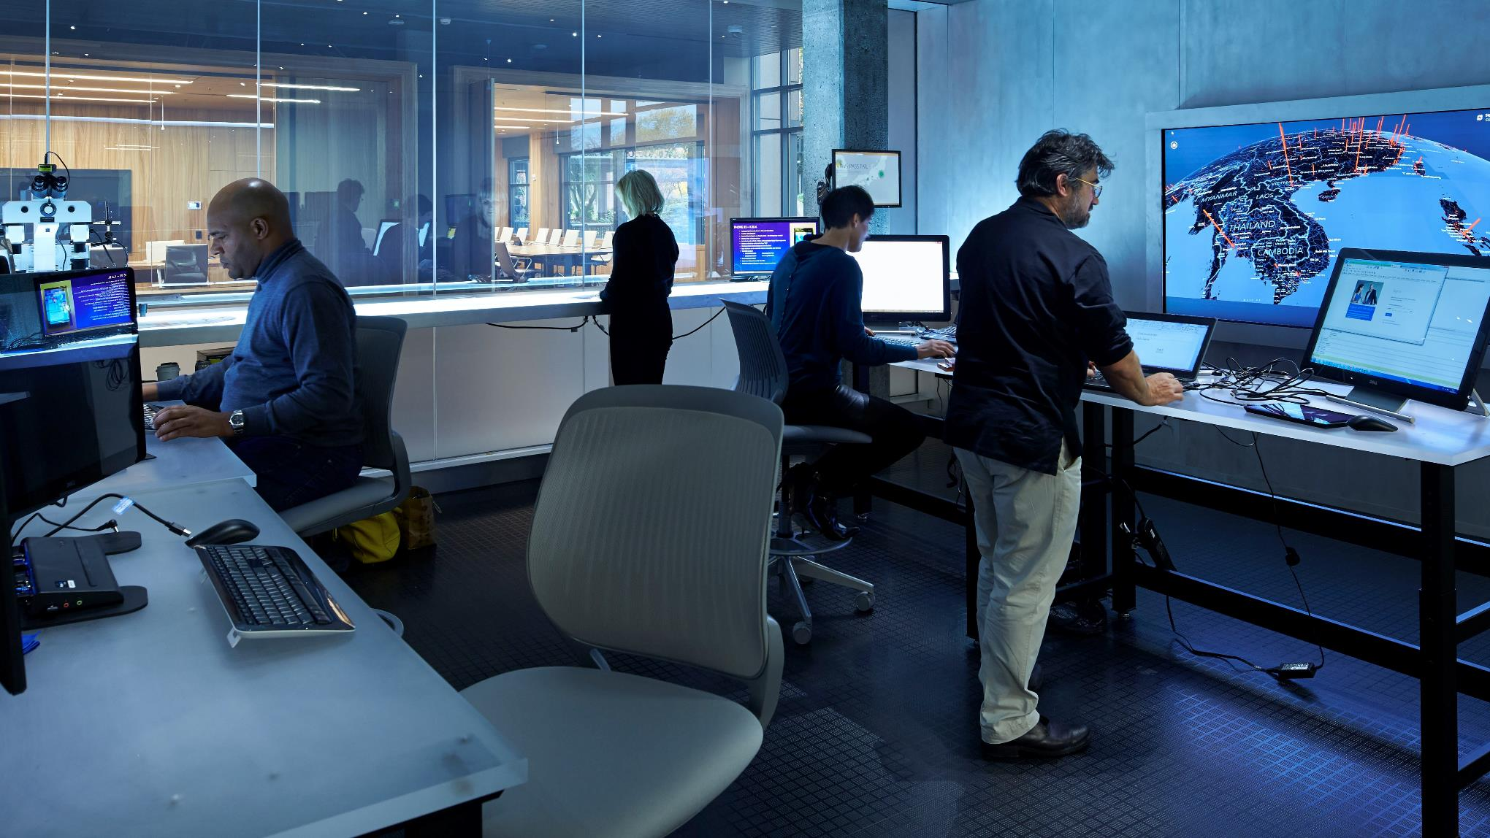
Respond
Notes:
Even with the best very defenses in place, breaches can and will occur. Whether it’s simple human error by someone or a previously unknown method of intrusion (like a new zero-day attack, for example), we all have to operate with the assumption that we’ve already been breached.
https://customers.microsoft.com/Assets/10ca2a71-9ccd-e411-bbbe-6c3be5a8e164/Microsoft%20Digital%20Crimes%20Photography.jpg

Slide 49
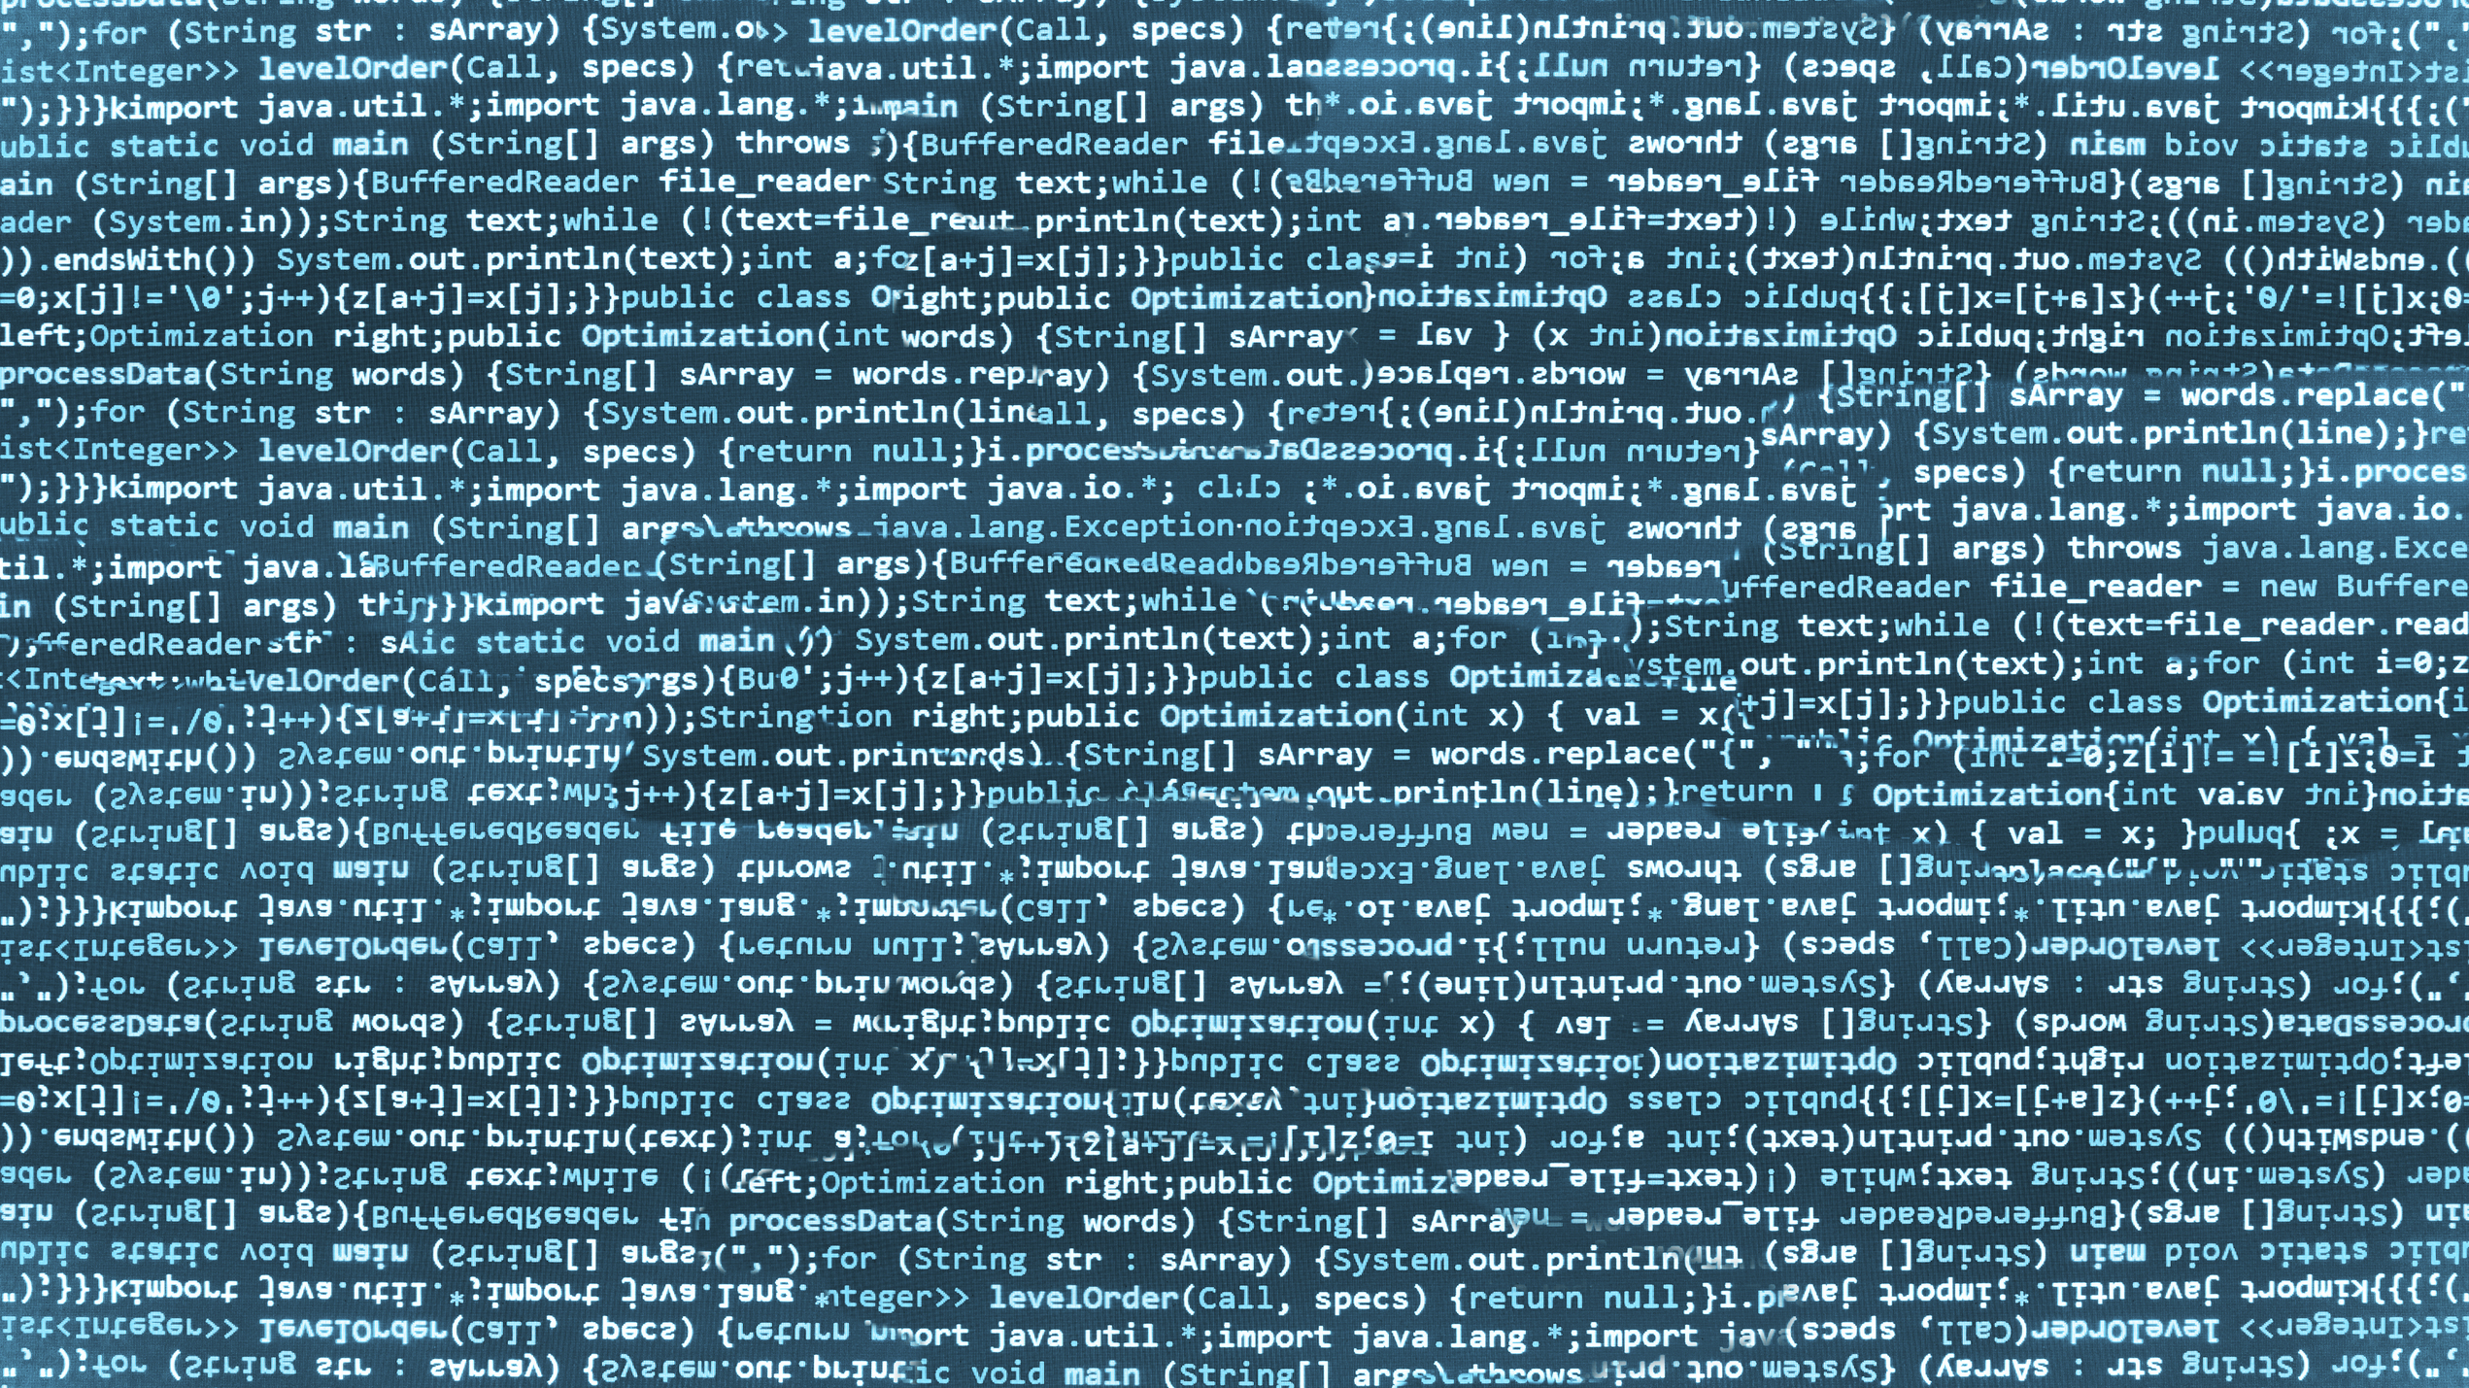
Assume breach
“There are two kinds
of big companies:
those who’ve been
hacked, and those
who don’t know
they’ve been hacked.”
—James Comey, Director, FBI
Notes:
In other words: Assume breach and have the tools and capabilities always working to identify the suspicious behaviors that are associated with compromised accounts, compromised devices, and the suspicious use of resources.
This is going to be one of the most important aspects of your management and security platform moving forward. As these attacks become more and more targeted and more and more sophisticated you must have a partner that is bringing together the broadest set of data about the threats that are happening around the globe combined with the actions and behaviors of your users and systems.
That type of security results in collection of a literal mountain of data. Data alone is not the answer, you need the capacity of processing, co-relating, find the patterns, eliminating tons of false positives, and provide quick remediation, in minutes, hours or realtime, not in days or taking your systems down. That is where Cloud services, powered by machine learning that is constantly operating on this data, is able to help you.
http://www.gettyimages.com/license/593481351

Slide 50

ADVANCED THREAT ANALYTICS
Identify advanced on-premises security attacks before they cause damage
Behavioral Analytics
Uncover suspicious activities and abnormal
behavior, leveraging machine learning
Detection for known threats
Forensic tools to search for known security attacks such as “pass the hash”
Focus on what’s important
Clear, efficient, and convenient timeline feed that
surfaces the right things along with recommendations
for investigation and remediation

Slide 51

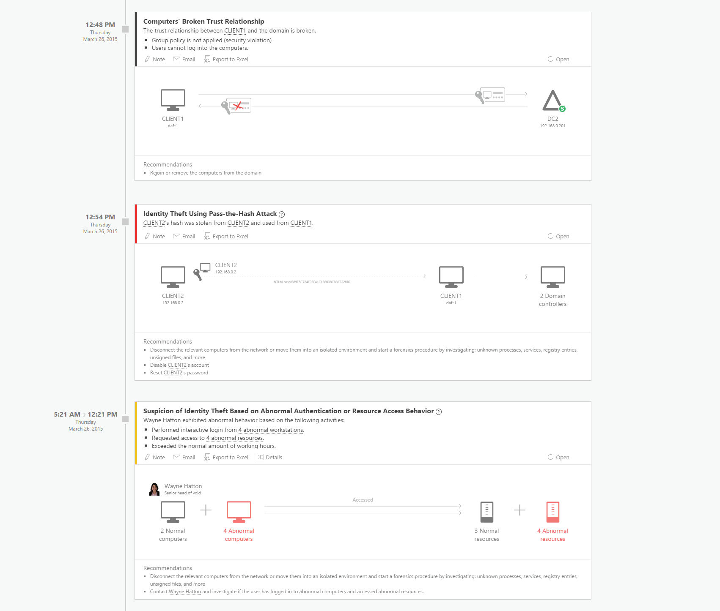

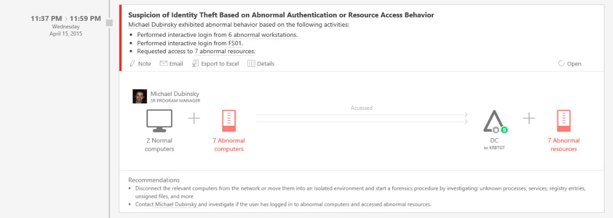

How Microsoft Advanced Threat Analytics works
Security issues and risks
Broken trust
Weak protocols
Known protocol vulnerabilities
Malicious attacks
Pass-the-Ticket (PtT)
Pass-the-Hash (PtH)
Overpass-the-Hash
Forged PAC (MS14-068)
Golden Ticket
Skeleton key malware
Reconnaissance
BruteForce
Abnormal Behavior
Anomalous logins
Remote execution
Suspicious activity
Unknown threats
Password sharing
Lateral movement
Notes:
ATA identifies known security issues using world-class security researchers’ work.
Broken trust
Weak protocols
Known protocol vulnerabilities
ATA detects known malicious attacks almost as instantly as they occur.
Pass-the-Ticket (PtT)
Pass-the-Hash (PtH)
Overpass-the-Hash
Forged PAC (MS14-068)
Golden Ticket
Skeleton key malware
Reconnaissance
BruteForce
Remote execution
Behavioral analytics leverage Machine Learning to uncover questionable activities and abnormal behavior.
Anomalous logins
Unknown threats
Password sharing
Lateral movement

Slide 52
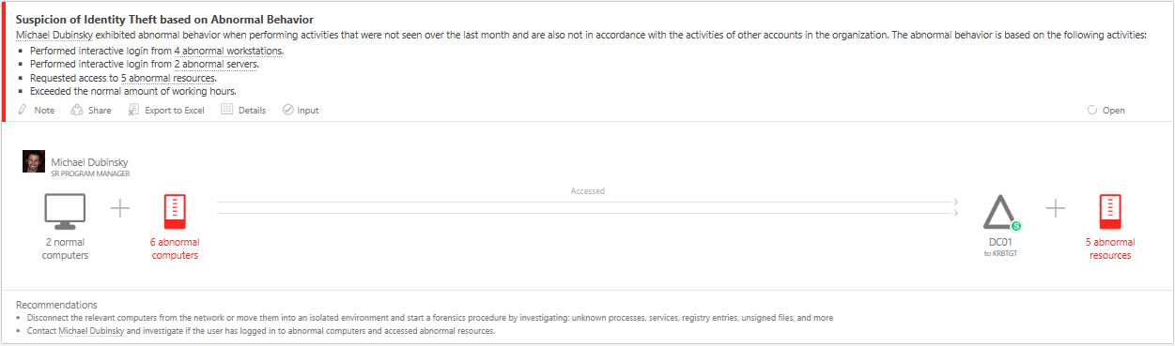
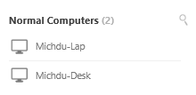
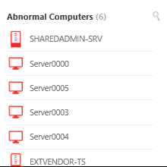
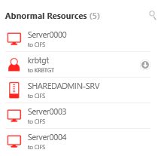
Microsoft Advanced Threat Analytics in action
Abnormal behavior
Behavioral analytics leverage Machine Learning to uncover questionable activities and abnormal behavior.
Anomalous logins
Unknown threats
Password sharing
Lateral movement

Slide 53
CLOUD APP SECURITY
Enterprise-grade security for your cloud apps
Discovery
Gain complete visibility and context for cloud
usage and shadow IT—no agents required
0101
1001
Data Control
Shape your cloud environment with granular controls
and policy setting for access, data sharing, and DLP
Threat Protection
Identify high-risk usage and security incidents, detect abnormal user behavior, and prevent threats

Slide 54
Microsoft Cloud App Security
Discovery
Information
protection
Threat
detection
In-session
control
Discover all cloud usage in your organization
Monitor and control your data in the cloud
Detect usage anomalies and security incidents
Control and limit user access based on session context
DISCOVER
INVESTIGATE
CONTROL
PROTECT

Slide 55
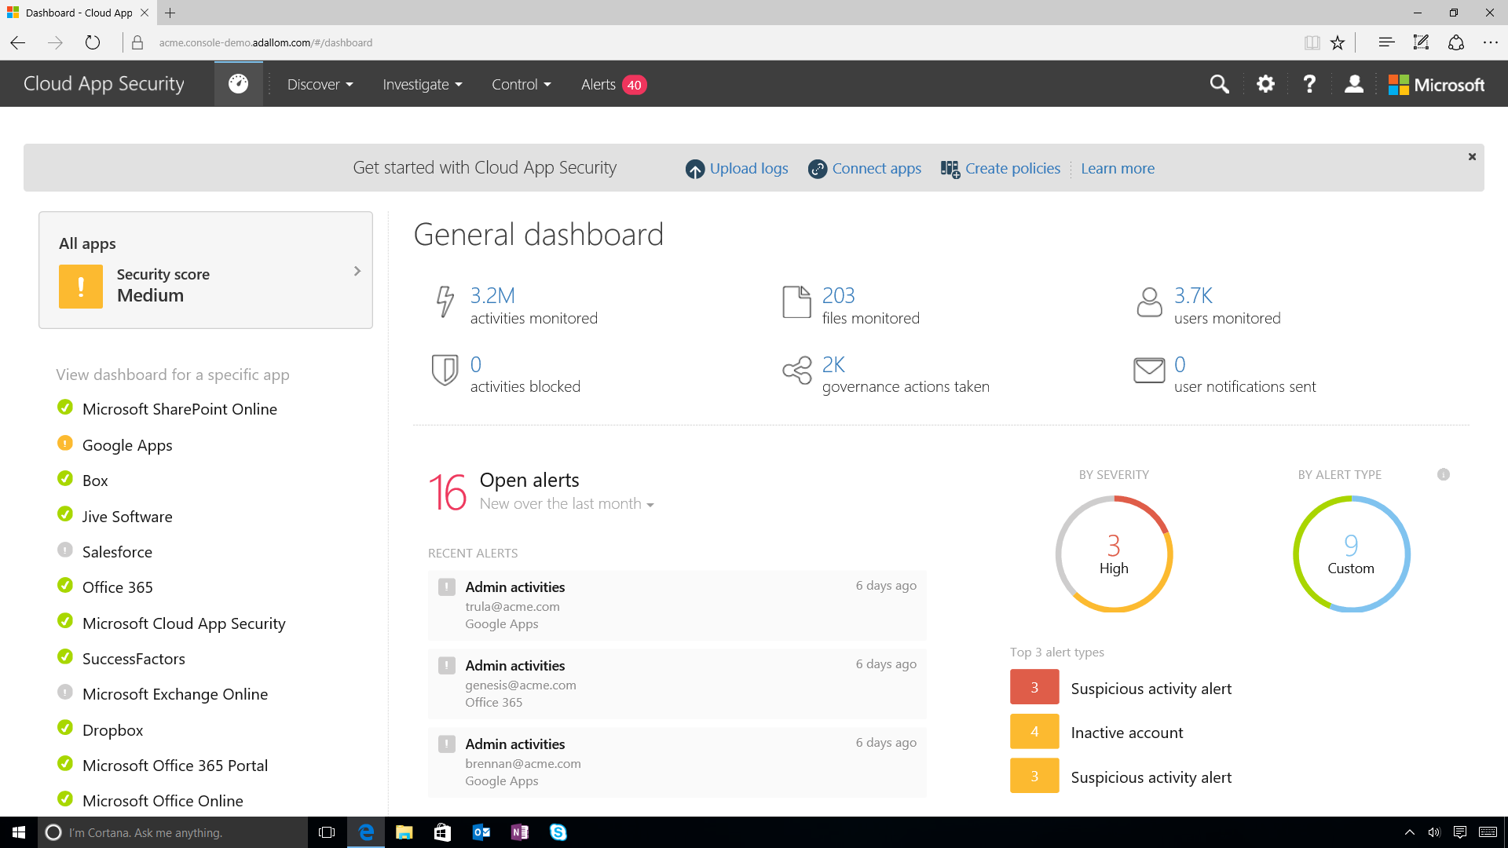
Notes:
Here you can see Microsoft Cloud App Security’s console.
You have four key menus at the top:
“Discover”, “Investigate”, “Control” and finally “Alerts” providing you a wide set of capabilities including visibility, comprehensive data controls and threat prevention for your cloud apps.
CLICK STEP(S)
Click the Discover menu.

Slide 56
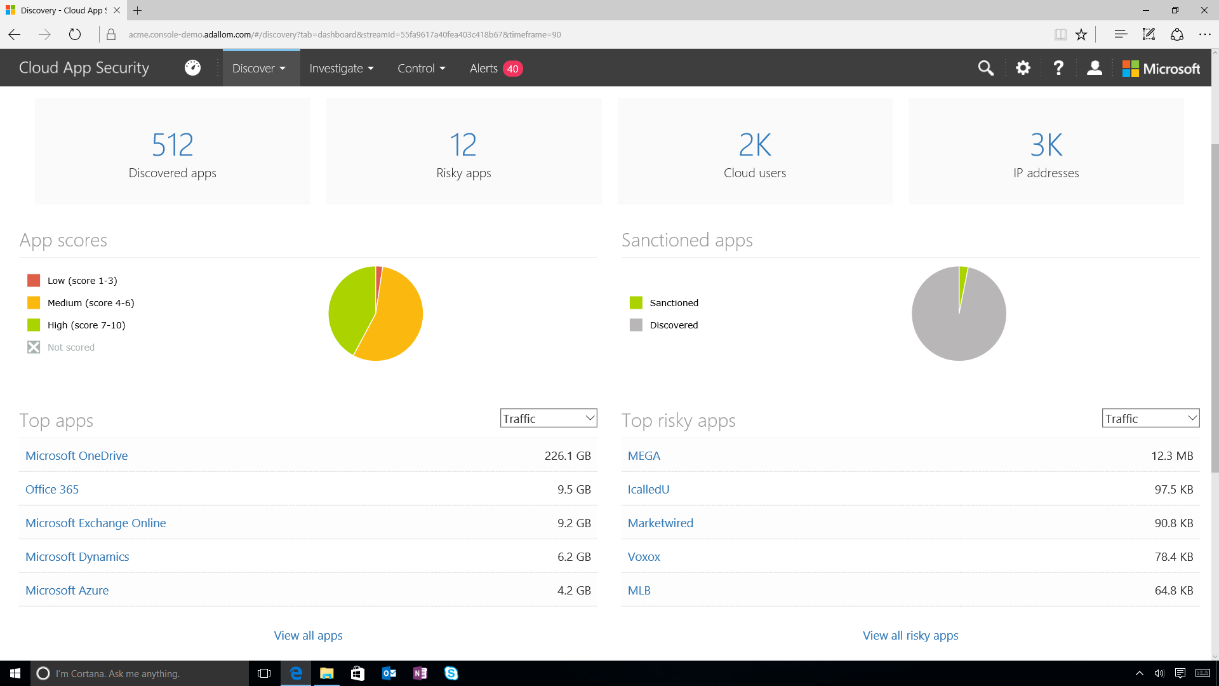
Notes:
It also conducts risk assessment and automated risk score for each app.
Your users do not need to deploy any agents on their devices for Cloud App Security to provide this analysis because we collect information from firewalls and proxies.
The Discovery dashboard provides an overview of cloud apps used in your organization with details.
CLICK STEP(S)
On the right, click on the scroll bar to scroll up.

Slide 57
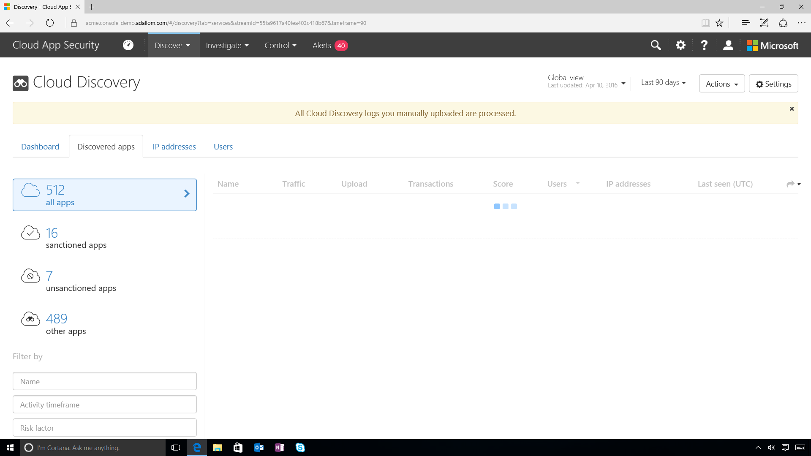
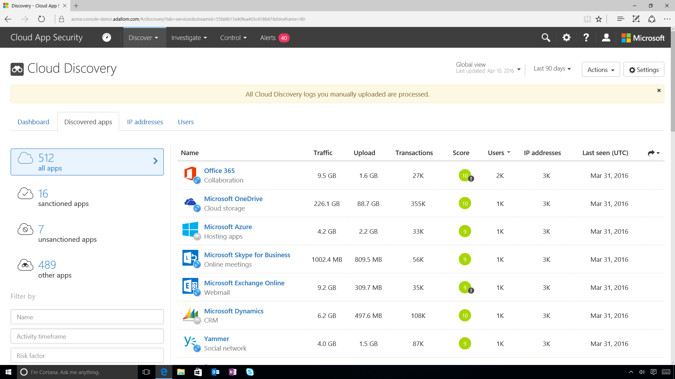
Notes:
Here you see all of the discovered apps in the organization.
You can see the applications that are sanctioned – or in other words approved by my organization.
CLICK STEP(S)
On the right, click the scroll bar to scroll down.

Slide 58
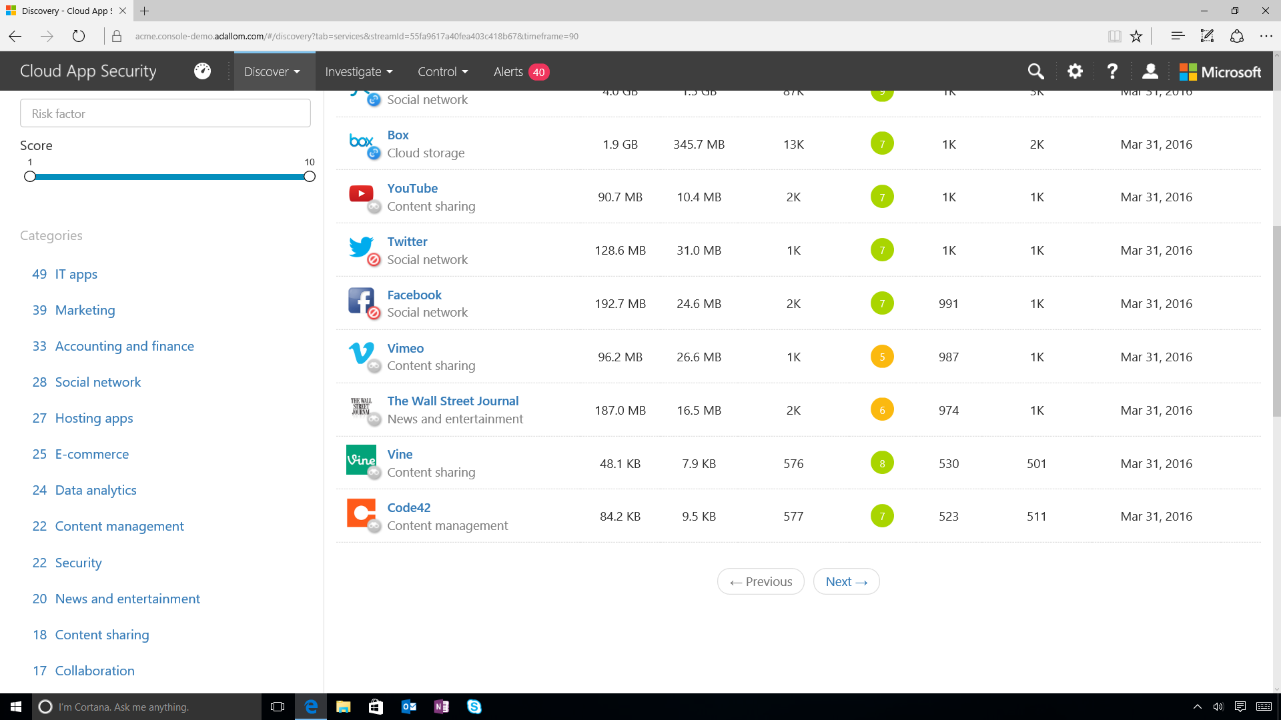
Notes:
You can see the unsanctioned apps and can easily filter based on the name, activity time frame or the risk score associated with the application.
You can also filter by a category: for instance collaboration apps.
CLICK STEP(S)
On the right, click scroll bar to scroll up

Slide 59
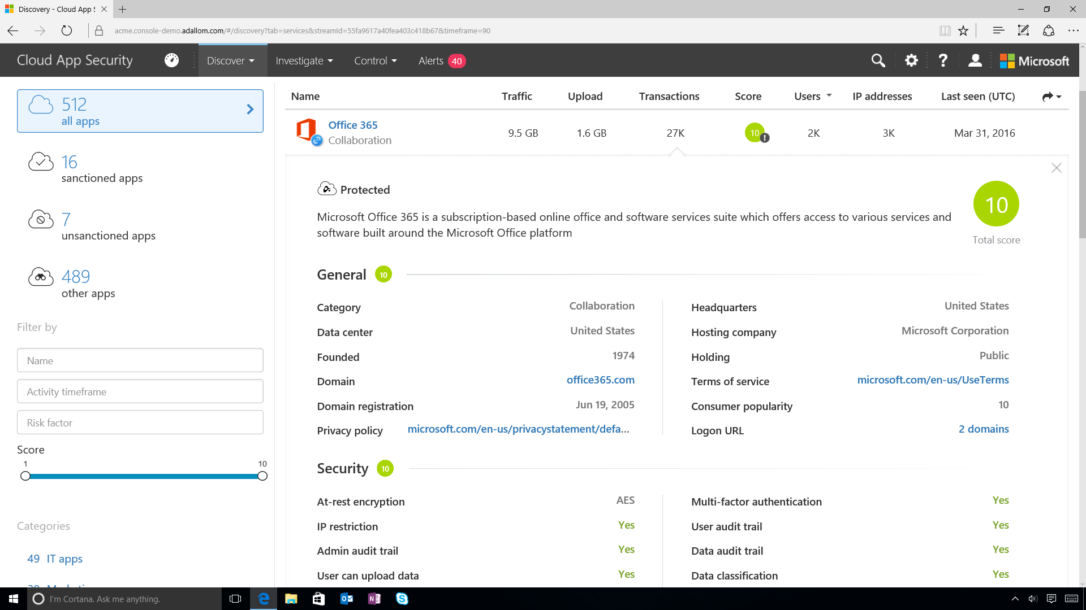
Notes:
With a simple drill down here is the risk assessment and risk score for Office 365.
CLICK STEP(S)
On the right, click the scroll bar to scroll down

Slide 60

Notes:
Cloud App Security not only discovers more than 13,000 cloud applications in use but it also provides an automated risk score by evaluating each discovered service against more than 60 parameters.
CLICK STEP(S)
On the right, click on the scroll bar to scroll up

Slide 61

Notes:
Here you can see all of the different parameters used for the risk evaluation.
Let’s look at an example of a parameter breakdown.
CLICK STEP(S)
On the bottom right of the slide, click on HTTP security headers.

Slide 62

Notes:
You can dive into more details for a specific parameter to get a breakdown on the score.
You can see the weight of this parameter in this category and which factors are considered for risk assessment.
You can interact with this risk assessment by reporting new data or requesting score update.
CLICK STEP(S)
Click outside of the pop up to make it disappear.

Slide 63

Notes:
CLICK STEP(S)
On the right, click on the scroll bar to scroll up.

Slide 64

Notes:
CLICK STEP(S)
Under the Name column, click on Office 365 to navigate to charts.

Slide 65


Notes:
Discovering which apps are in use across your organization is just the first step in making sure your sensitive corporate data is protected.
CLICK STEP(S)
On the right, click on the scroll bar twice to scroll down.

Slide 66


Notes:
Cloud App Security also provides powerful reporting and analytics capabilities for you to gain the complete context of your cloud usage: such as usage patterns, upload/download traffic and top users.
CLICK STEP(S)
On the right, click on the scroll bar to scroll up.

Slide 67

Notes:
Here you have a file policy for PCI compliance for identifying sensitive, publicly shared files containing customer credit card numbers and providing options for investigation and remediation.
If you click on the policy, I will see all files violating this policy.
CLICK STEP(S)
Click on the PCI COMPLIANCE policy.

Slide 68

Notes:
For the 1st scenario, you will see how Cloud App Security allows you to react and take action against suspicious activity and/or violations using the Payment schedule and details.xlsx spreadsheet.
Let’s view the file details for the Payment schedule and details.xlsx spreadsheet and do further investigating.
CLICK STEP(S)
Click on Payment schedule and details.xlsx.

Slide 69

Notes:
You can see the owner of the file, all the collaborators, when it was created, when it was modified.
CLICK STEP(S)
On the far right side, click on the more information icon (3 vertically stacked dots) for the Payment schedule and details.xlsx file.

Slide 70

Notes:
By clicking on view hierarchy, you can see the file hierarchy in details.
CLICK STEP(S)
Click View Hierarchy.

Slide 71

Notes:
This file is located under one of our customer information folders and it looks suspicious to have it available in a public link.
CLICK STEP(S)
On the far right side, click on the more information icon (3 vertically stacked dots) for the Payment schedule and details.xlsx file.

Slide 72

Notes:
You can now make an assessment with the given evidence and take action, by either “put in user quarantine” or “make the link private”.
CLICK STEP(S)
Click the more information icon again to close drop down menu.

Slide 73


Notes:
The alerts center gathers alert of a wide variety of categories, including threat detection, privileged accounts and compliance violations.
CLICK STEP(S)
On the right, click on the scroll bar to scroll down.

Slide 74

Notes:
Lets see an alert.
CLICK STEP(S)
Click on General Anomaly Detection (3rd from the top).

Slide 75


Notes:
Cloud App Security advanced machine learning heuristics learns how each user interacts with each SaaS app and through behavioral analysis, assesses the risk in each transaction.
CLICK STEP(S)
On the right, click on the scroll bar to scroll down.

Slide 76

Notes:
Here you can see a user who is an administrator performing suspicious activities such as logging in from a new anonymous location and two countries simultaneously within an hour with several failed login attempts.
You can take look at the details of the activity and take action to mitigate any threats right away.
Closing remarks: As you have seen in this demonstration, Microsoft Cloud App Security is a comprehensive solution for gaining deeper visibility, stronger controls and enhanced security for your cloud apps. We not only support Microsoft cloud apps. We are committed to help you secure third party cloud apps as well.
If you would like to learn more about this new Microsoft service, please visit us at: www.cloudappsecurity.com

Slide 77


What to do next?
Protect
Detect
Respond
Notes:
We’ve built these things because we believe that it’s critical for you to have a solution in place that enables you to do the following 3 things:
Protect: secure access
Detect: stop malicious or unintentional data leakage and breaches
Respond: identify suspicious behaviors, block and remediate attacks
Across users, devices, apps and data, and infrastructure. Your data is safer in the cloud and protected from the cloud.
All of these capabilities are now native to Windows, Office 365, EMS and Azure.
We have been working on these solutions for a number of years, and they have been carefully engineered to work seamlessly together. This seamless interoperation is how you get the greatest value and the best possible protection.

Slide 78
Enterprise Mobility + Security
Extend enterprise-grade security to your cloud and SaaS apps
Microsoft Cloud App Security
Microsoft
Intune
Azure Active Directory Premium
Manage identity with hybrid integration to protect application access from identity attacks
Azure Information Protection
Protect your data, everywhere
Protect your users, devices, and apps
Detect threats early with visibility and threat analytics
Microsoft
Advanced Threat Analytics
Notes:
Microsoft’s enterprise & security solutions provide a holistic framework to protect your corporate assets across, on prem, cloud and mobile devices
Advanced Threat Analytics helps IT detect threats early and provide forensic investigation to keep cybercriminals out
Azure Active Directory Premium security reports help identify risky log ins. That paired with Azure Active Directory Identity Protection gives IT the ability to automatically block access to apps based on real time risk scoring of identities and log ins.
Microsoft Cloud App Security provides deep visibility and control of data inside cloud applications
Microsoft Intune manages and secures corporate data on mobile devices and collaborated within corporate apps.
Azure Information Protection helps keep data secure and encrypted throughout a customers environment and extends security when data is shared outside the organization.

Slide 79


Slide 80
Thank You!

